Slide 1
Synthetic Blood Products
Presented By connor buckley

Slide 2
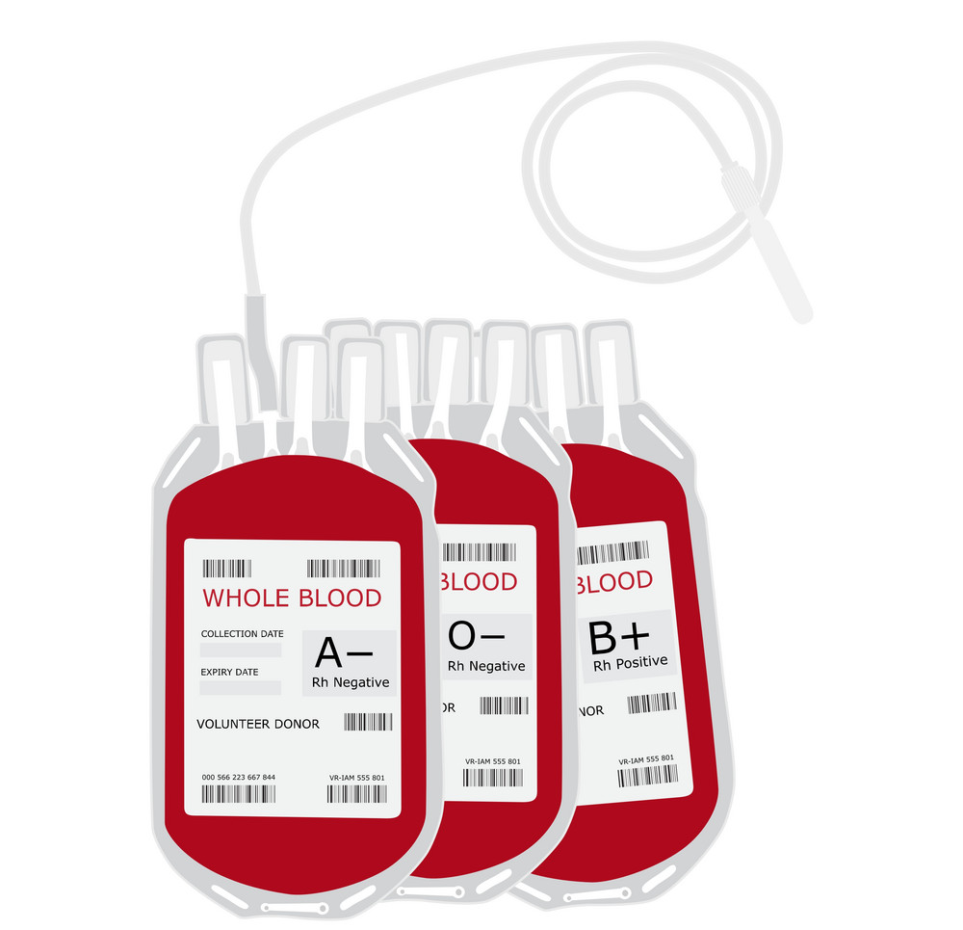
Blood transfusion practices
Used in treatments of anemia and blood diseases
Helps in traumatic injuries
Can make up for blood loss in surgery
Can help patients undergoing chemotherapy or radiation

Slide 3
Current blood product limitations
Production
High demand of ~50,000 units needed per day
Limited storage time
Contamination potential
Decreases in donations
Transfusion Reactions
Hemolytic reactions
Acute lung injuries
Circulatory overload
Allergic reactions

Slide 4
Deaths per year due to transfusion reactions
2017
44 Deaths
2018
43 Deaths
2015
2016
41 Deaths
44% TACO
2014
56 Deaths
43% TRALI
32% TRALI
60 Deaths
30% TACO
39% TACO

Slide 5
History of synthetic blood research
World War II led to the increase in demand for blood products which led to research in substitutes which was abandoned due to lack of knowledge at the time
Increases in HIV cases in the 1980’s brought new interest in blood substitutes to prevent the spread of infections through blood transfusion

Slide 6
Synthetic Blood Products
Hemoglobin Based Oxygen Carriers (HBOC)
Perfluorocarbons (PFC)
Natural hemoglobin used as a base for the products
Used as free cell hemoglobin or encapsulated
Transfusion of cell-free hemoglobin attempted as early as 1950’s
Minimal antigenicity
Fully synthetic oxygen carrier
Oxygen bound by van der Waals interaction
High oxygen offloading potential
Briefly approved by FDA in 1989

Slide 7
Chemically modified Free-cell HBOC
Cross linking the alpha-subunits would increase circulation time but at increased cardiac events
Hemoglobin conjugated with polyethylene glycol (PEG) showed better stability with reduced immune recognition but still caused cardiac and renal dysfunction
Incorporation of RBC redox enzymes or regulatory molecules attempted to prevent oxidative stressors but currently no products have shown in vivo progress
Due to poor circulation times, the instability of natural free hemoglobin, and the irreversible binding of nitric oxide had led to the research of crosslinking hemoglobin structures.

Slide 8
Encapsulated HBOC
PEG-polylactide shells allowed RBC like transport but was rapidly removed by macrophages
Stealth liposome and plymersome capsules allowed for decreased removal with less nephrotoxicity and allowed for freezing
Capsules began being shaped like RBCs to mimic the particle behavior within the bloodstream
Encapsulation was designed for greatly increased stability and protection from oxidative stress that mimics the red blood cell.

Slide 9
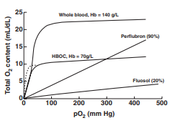
Perfluorocarbon oxygen carriers
Physically dissolves oxygen and loosely binds to allow for easier dissociation compared to HBOCs
Products have shown positive outcomes as a blood replacement in surgeries, hemodilution, and hemorrhages
Side effects are mainly thrombocytopenic effects in animal models
A parallel study created in an attempt to solve the toxicity of HBOCs that have the unique property of being hydrophobic and lipophobic.

Slide 10
FDA approval Studies
Flousel-DA, a PFC system developed in Japan, is the only blood substitute that has been approved for use by the FDA but was removed after a few years due to premature oxygen release, instability, thrombocytopenic activity and other serious side effects.
HBOC products are still being reviewed by the FDA but are often too toxic. FDA researchers contribute to understanding the toxicity of each product and provides possible strategies to overcome the limitations.
PFC systems are currently approved in ultrasound imaging and are expected to be more successful as oxygen carriers and current FDA studies have been showning better outcomes in animals.

Slide 11
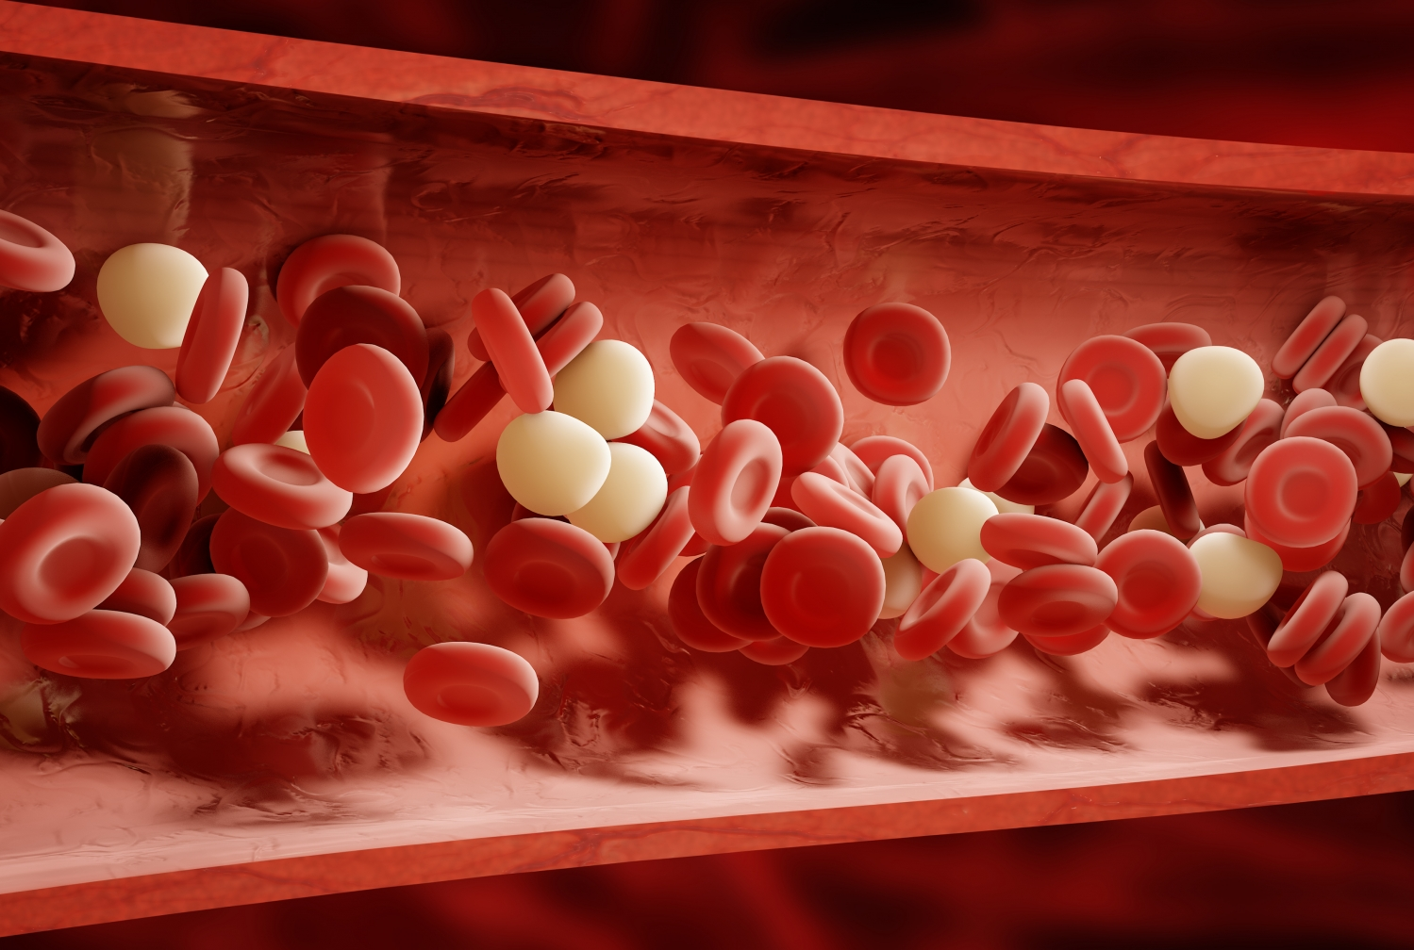
Limitations to overcome
Limited availability of natural hemoglobin sources
Maintaining high loading efficiency to oxygen
Providing a longer circulation lifetime
Leakage of free hemoglobin within circulation
Minimizing nitric oxide binding

Slide 12
bibliography
Biologics Evaluation and Research. (n.d.). Evaluating Safety and Efficacy of Hemoglobin-based Blood Substitutes. Retrieved April 13, 2020, from https://www.fda.gov/vaccines-blood-biologics/biologics-research-projects/evaluating-safety-and-efficacy-hemoglobin-based-blood-substitutes
Biologics Evaluation and Research. (n.d.). Potential Toxic Effects of Engineered Nanoparticles & Microparticles. Retrieved April 13, 2020, from https://www.fda.gov/vaccines-blood-biologics/biologics-research-projects/investigation-potential-toxic-effects-engineered-nanoparticles-and-biologic-microparticles-blood-and
Biologics Evaluation and Research. (2020, April 13). Transfusion/Donation Fatalities. Retrieved April 13, 2020, from https://www.fda.gov/vaccines-blood-biologics/report-problem-center-biologics-evaluation-research/transfusiondonation-fatalities
Gupta, A. S. (2017). Bio-inspired nanomedicine strategies for artificial blood components. Wiley Interdisciplinary Reviews: Nanomedicine and Nanobiotechnology, 9(6). doi: 10.1002/wnan.1464
National Blood Supply. (n.d.). Retrieved April 13, 2020, from https://www.vitalant.org/Learn/National-Blood-Supply.aspx

