Slide 1
Characteristics of Simonsiella and A review of Testing methods
Tiffany Matthews, Montana Medical Laboratory Sciences, Montana University System
Spring 2020
Tiffany.Matthews@umontana.edu

Slide 2
Learning Objective
After this presentation, participants will be able to describe the characteristics of Simonsiella isolated from the oral cavity of cats in Missoula, Montana, and identify the microbe in a clinical situation.

Slide 3
abstract
Simonsiella is a genus of understudied microbes that have been found almost exclusively in the oral cavities of mammals. Clinically, this microbe may be encountered in oral lesions and bite wounds from animals harboring it (1–4). Cats are the most likely mammal with known Simonsiella colonization to have a bite become infected – 30-50% of cat bites become infected and require medical intervention (2). Simonsiella, although very distinct microscopically, has biochemical reactions that may make identification difficult, if merely following hospital protocol as an MLS (4–6). Swabs taken from the mouths of shelter cats at the Missoula Animeals were cultured for Simonsiella using methods previously used by Kuhn and colleges (5, 6), then evaluated using the wound culture protocol at Community Medical Center to ensure proper identification would be made. Next, a series of common biochemical tests were performed to collect an overall characteristic chart for the strains isolated. Finally, anti-microbial resistance to the most common antimicrobial prescribed for bite wounds (3) and oral lesions (1) was tested for each sample to ensure standard medical protocols are sufficient for the treatment of Simonsiella strains in cats in the Missoula area. Overall, this data helps confirm the validity of methods at Community Medical Center and serves as an additional resource for diagnostic characteristic data for Simonsiella strains found in cats in and around Missoula, Montana.
Key Words: Simonsiella, Cat Bites, Infection, Biochemical Testing, Microbiology, Identification

Slide 4
introduction
Simonsiella is a relatively unknown organism with clinical significance in bite wounds and oral lesions
The increasing lifespan and number of individuals with immunocompromising conditions will likely lead to an increase in infections with commensal organisms (2)
The goal of this research is to contribute to the study of relevant, but understudied microorganisms, especially commensals and ensure proper identification under normal laboratory procedures
Laboratorian awareness of uncommonly seen microbes will help in the diagnosis and treatment of these individuals
30-50% of cat bites will develop an infection needing treatment due to their small and sharp teeth (2)

Slide 5
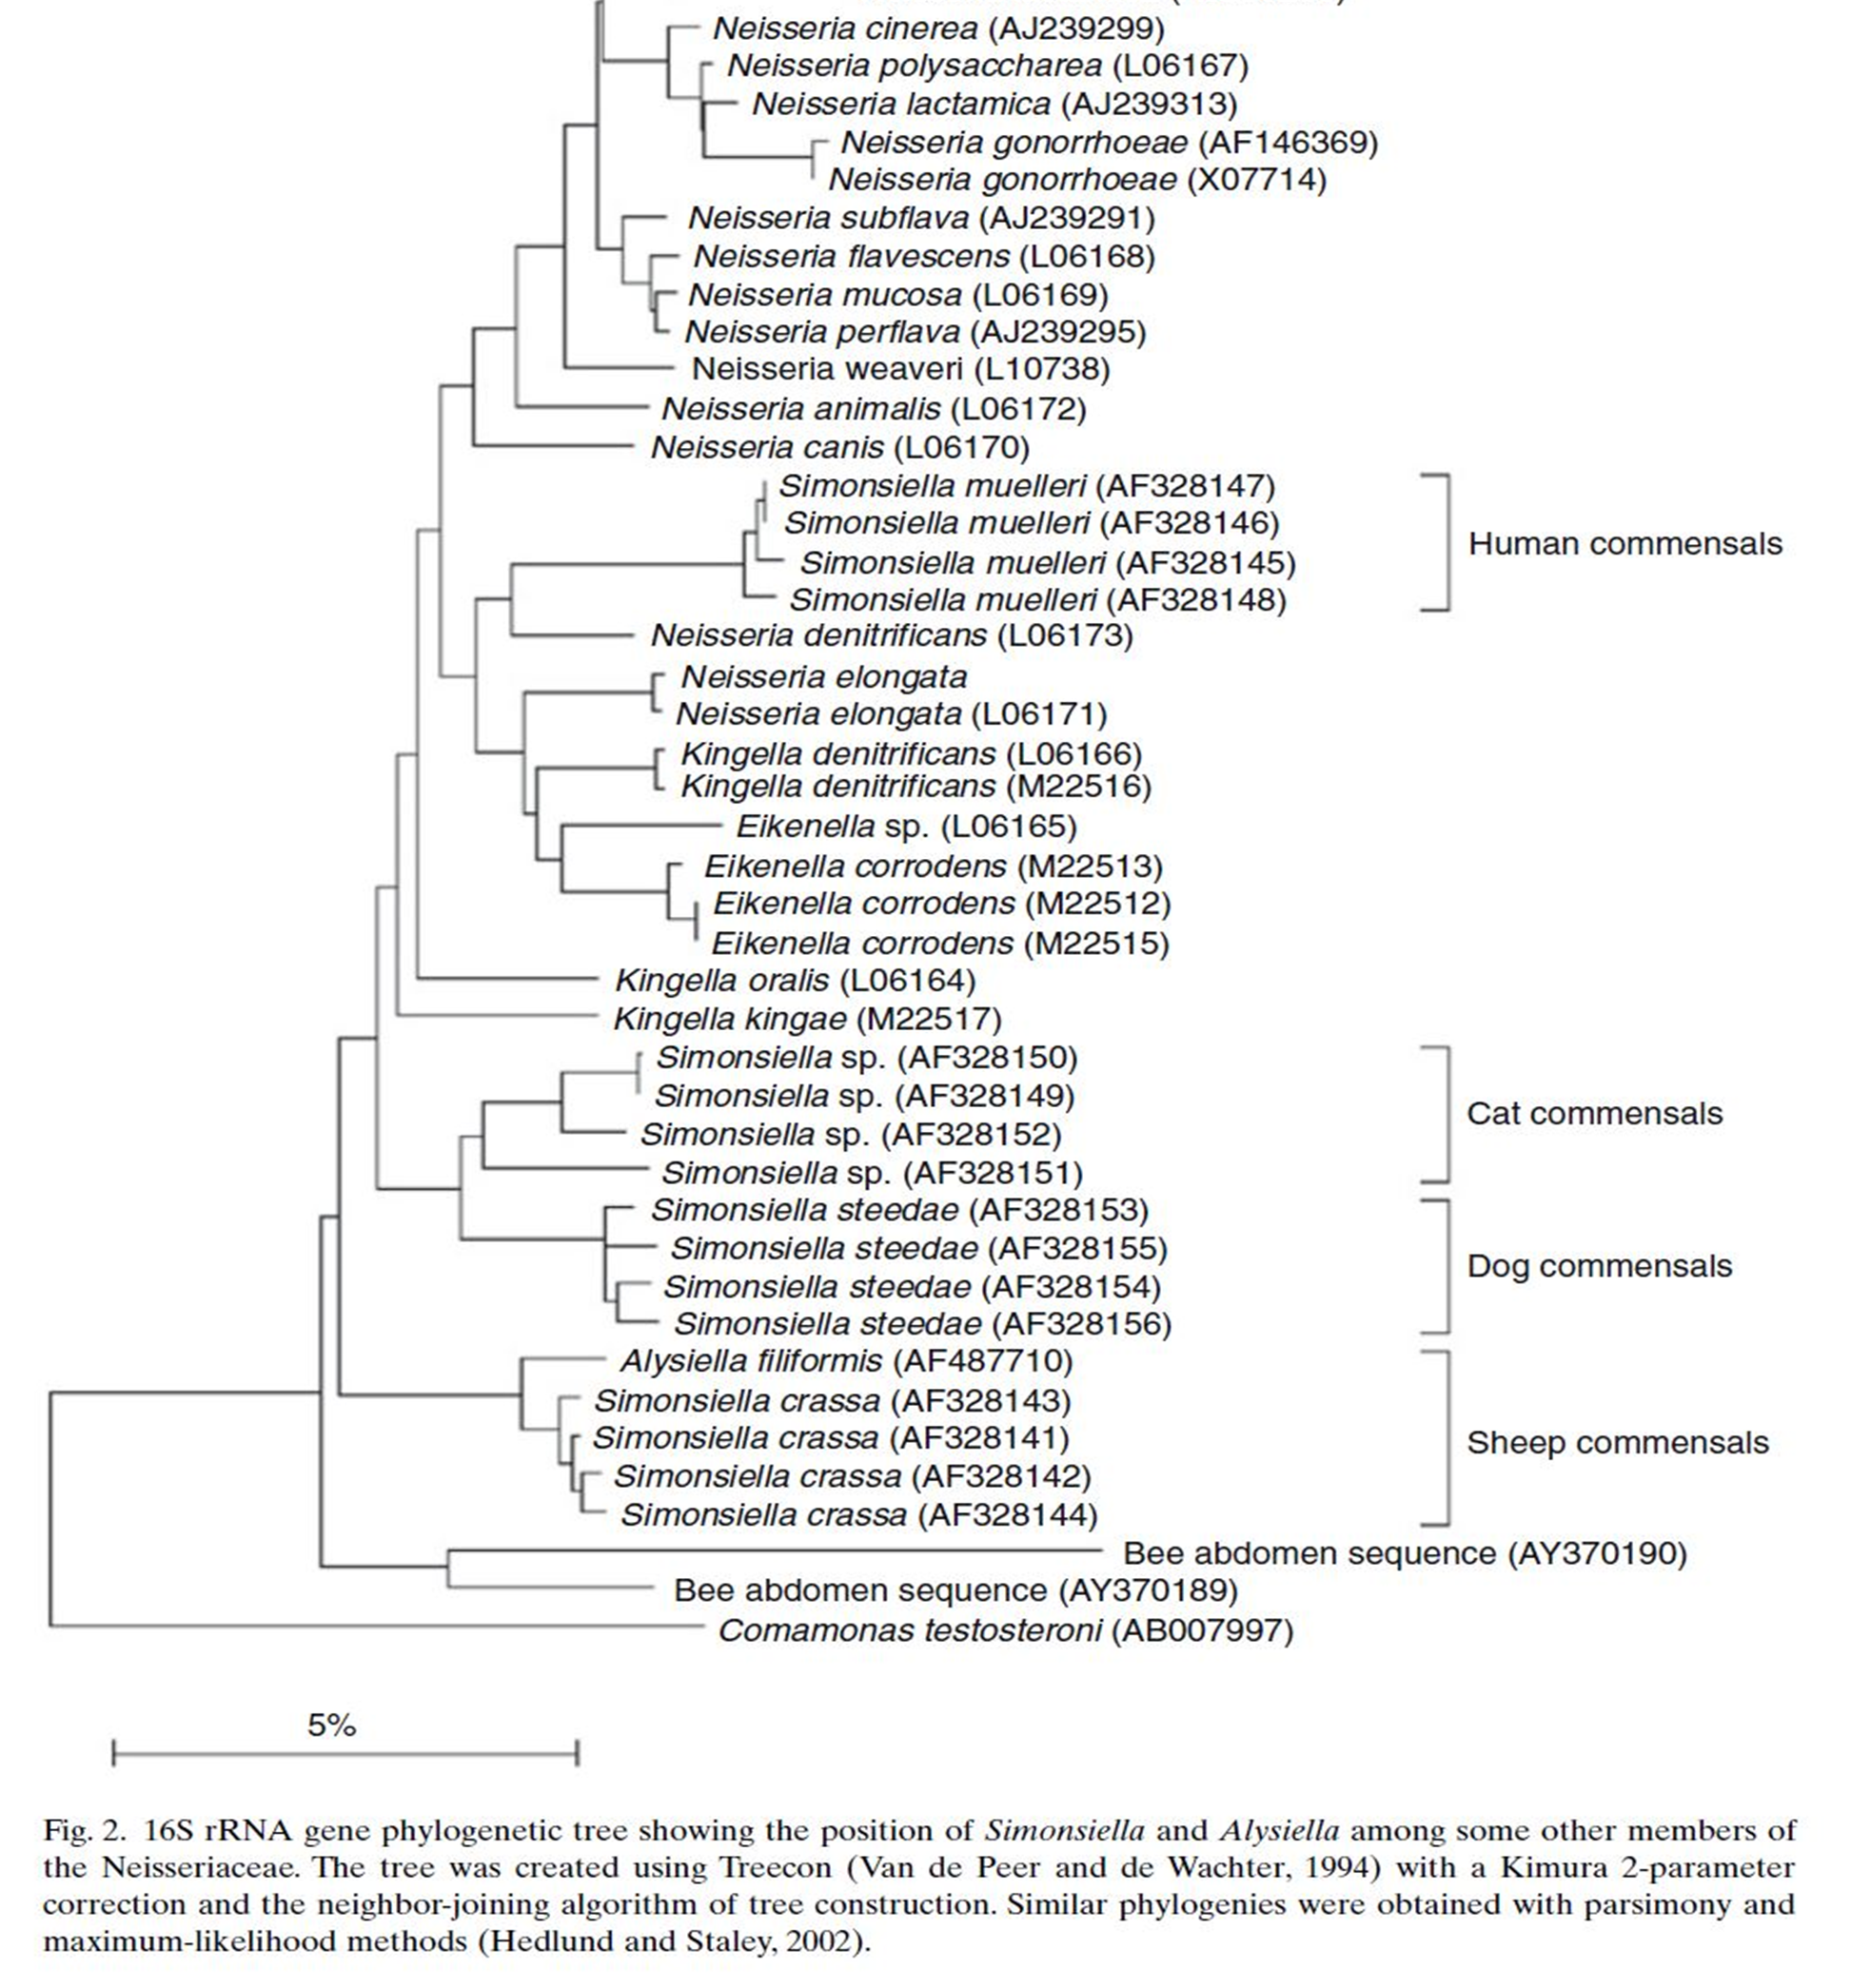
Simonsiella origins
Simonsiella is closely related to Neisseria, Kingella, and Eikenella species
These are normal mouth flora in humans (1,6) and other mammals (6)
Simonsiella spp. found in cats are extremely understudied
A specific epithet name has not yet been assigned to them (6)
Above: Phylogeny of Simonsiella spp. as compared to related species (6).

Slide 6
Materials
Amies Swab Transport System
PYR Kit
Sheep Blood Agar
Chocolate Agar
Mueller Hinton agar
Mueller Hinton with Blood Agar
CNA Agar
Thayer Martin Agar
MAC Agar
Indole
Antibiotic disks
Oxidase Kit
TSI slant tube
Incubators (37℃ and 42℃)
Refrigerator (4℃)
Catalase Kit
Slides
Gram Stain Kit
Anaerobe Packs
CO2 Packs
Sealable Pouches

Slide 7
Methods
Samples of the anterior palate of cats from Animeals were collected on Amies swabs (n=20)
Swabs were transported at room temperature (25℃) and immediately plated on SBA agar
After one day of growth, beta hemolytic colonies were gram stained to confirm as Simonsiella and subbed to new SBA plates
After sufficient growth, the pure organism was gram stained to confirm identity
Colonies were subbed to various media and growth conditions, observations were made after 1 day of growth at 37℃
Chemical testing was performed on colonies using manufacturer’s instructions after 1 day of growth at 37℃
Left: Original Isolation plates of cat anterior palate samples grown at 37℃ for 1 day

Slide 8
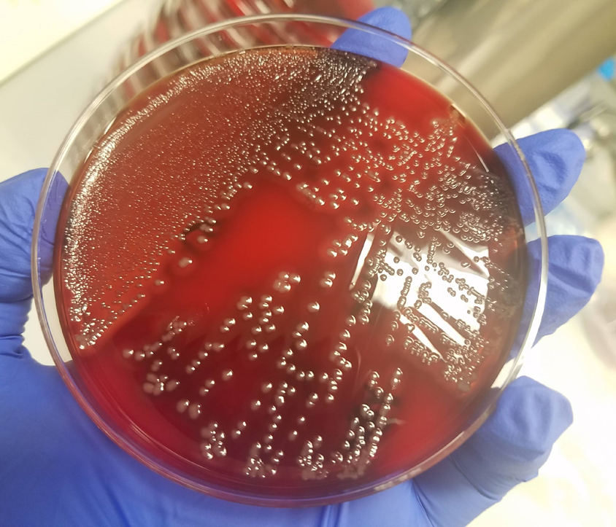
Results overview
Simonsiella spp. isolated from the anterior palate of cats in the Missoula area are fastidious, capnophilic organisms that grow best at or above body temperature
The best media for the isolation of Simonsiella available in clinical labs is SBA agar (4)
These Simonsiella spp. are facultative anaerobes, growing very slowly in an anaerobic environment
The tested Simonsiella spp. are relatively unreactive with common clinical laboratory chemicals
Above: Isolated Simonsiella on SBA after 1 day at 37℃

Slide 9
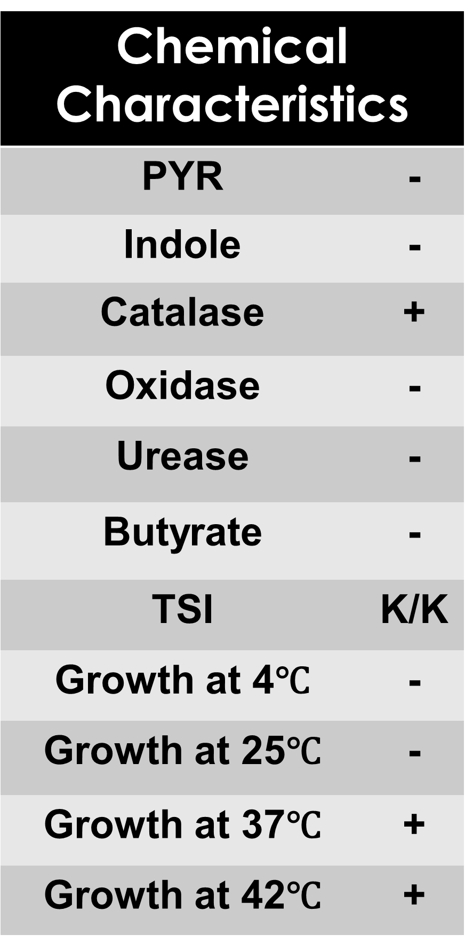
Results
Tests and media were selected based on availability and the Community Medical Center Microbiology procedures for both wounds and throat cultures
No growth cultures were kept for stated number of days
Slight growth = growth in 1 quadrant
Moderate growth = growth in 3 quadrants with small colonies
Excellent growth = growth in 3 quadrants with large colonies

Slide 10
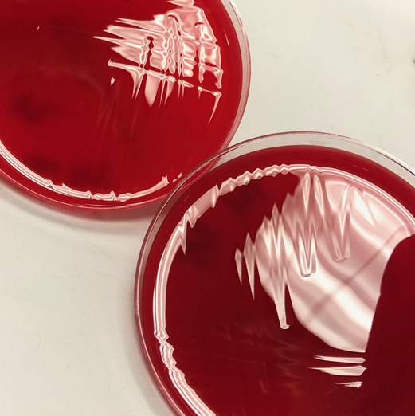
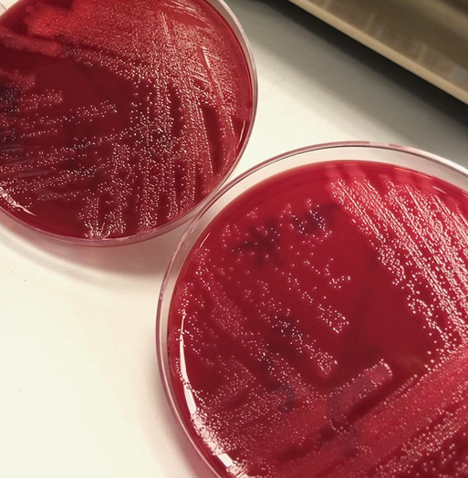
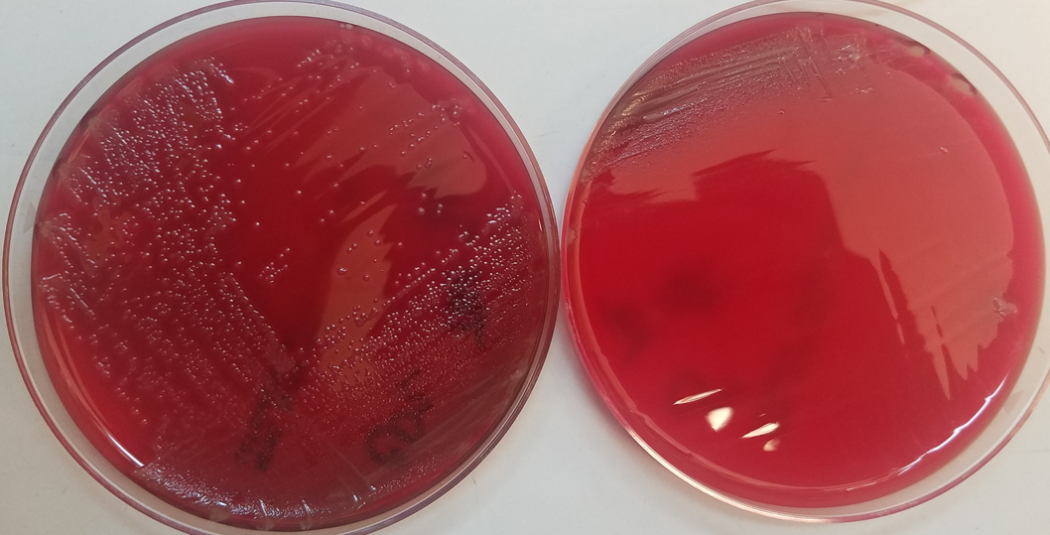
Results
Above: Aerobic SBA plate (Left) vs Anaerobic SBA plate (Right)
Above: 37℃ (bottom) and 42℃ (top) SBA plates in CO₂
Above: 4℃ (top) and 24℃ SBA plates (bottom) in CO₂
Growth at 37℃ in an anaerobic environment shows slight ability to utilize non-oxygen chemicals as electron receptors
Growth at both 37℃ and 42℃ shows growth at a range of biological body temperatures (an average cat body temperature is about 39℃ (2))

Slide 11
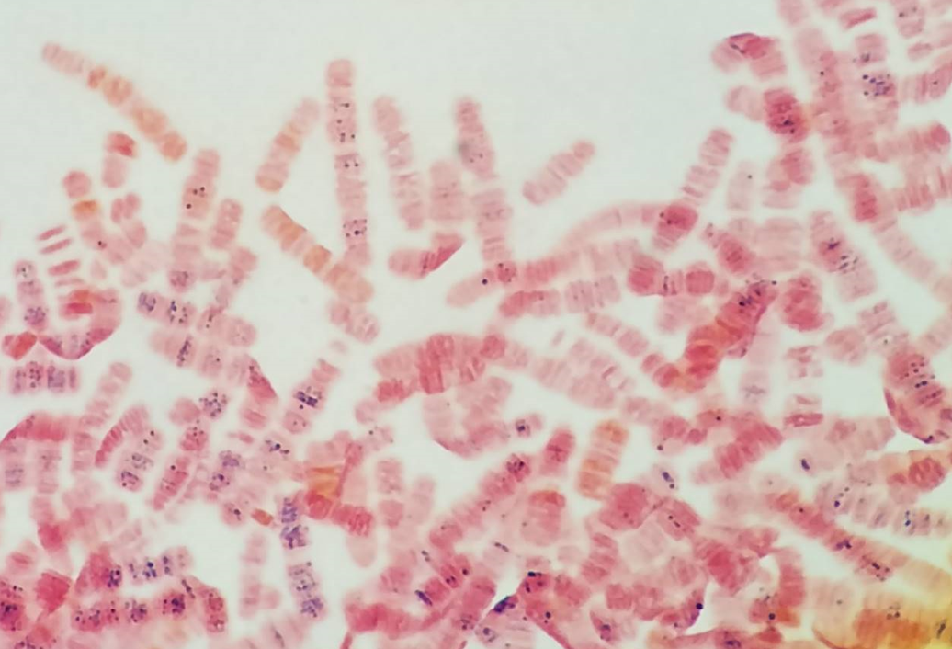
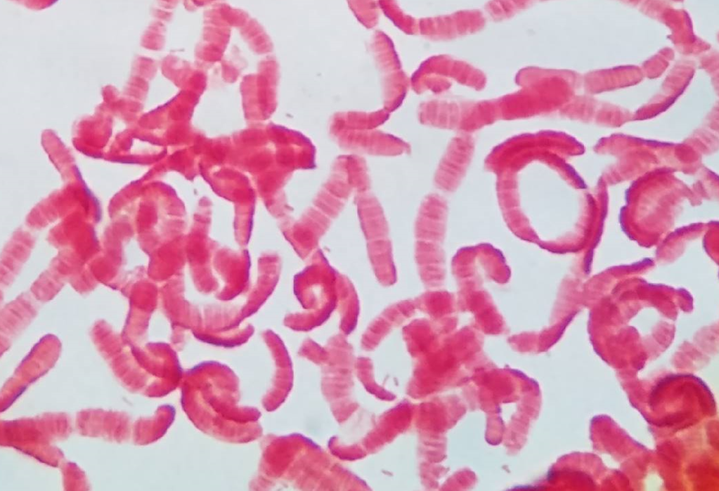
Results
The most common antibiotic prescribed for animal bites is amoxicillin with clavulanic acid (3)
Tested susceptibility with amoxicillin, clavulanic acid, and other common microbials using Mueller Hinton plates and antibiotic disks
Antibiotic susceptibility results
Simonsiella will not grow on Mueller Hinton agar or Mueller Hinton agar with blood
Lack of research means that there are no standards for testing susceptibility on other media or on the bioMerieux Vitek
No susceptibility data was received
Above and Below: Gram Stains of Simonsiella samples isolated from pure cultures after 1 day of growth

Slide 12
Conclusions
Following laboratory procedures at Community Medical Center:
In a throat culture, a Simonsiella would likely be called a non-group B streptococcus and not be identified further – likely clinically insignificant
In a wound culture, a Simonsiella would likely be identified immediately via gram stain
Standard treatment with Amoxicillin/Clavulanic Acid should suffice for most patients with a Simonsiella in a bite wound
Ultimately, the best way to identify Simonsiella spp. is by their unique gram stain morphology

Slide 13
Literature Cited
1. Carandina G, Bacchelli M, Virgili A, Strumia R. 1984. Simonsiella filaments isolated from erosive lesions of the human oral cavity. J Clin Microbiol 19:931-933.
2. Esposito S, Picciolli I, Semino M, Principi N. 2013. Dog and cat bite-associated infections in children. Eur J Clin Microbiol Infect Dis 32:971-976.
3. Jaindl M, Oberleitner G, Endler G, Thallinger C, Kovar FM. 2016. Management of bite wounds in children and adults—an analysis of over 5000 cases at a level I trauma centre. Wien Klin Wochenschr 128:367-375.
4. Hedlund BP, Staley JT. 2002. Phylogeny of the genus Simonsiella and other members of the Neisseriaceae. Int J Syst Evol Microbiol 52:1377-1382.
5. Kuhn DA, Gregory DA, Buchanan GE, Nyby MD, Daly KR. 1978. Isolation, Characterization, and Numerical Taxonomy of Simonsiella Strains from the Oral Cavities of Cats, Dogs, Sheep, and Humans 241:235-241.
6. Kuhn DA. 1981. The Genera Simonsiella and Alysiella. The Prokaryotes 390-39

Slide 14
Question
What is the most common antibiotic prescribed for animal bites?
a. Doxycycline
b. Amoxicillin/Clavulanate
c. Ampicillin
d. Sulfamethoxazole/Trimethoprim
Notes:
Answer: B

Slide 15
Acknowledgements
MMLS Program
The University of Montana
Montana State University
ASCLS –MT
Community Medical Center
- Special Thanks to the Laboratory Staff
Laurie Norberg

