Slide 1
Should dress code policies relax to reflect cultural trends in light of a workforce shortage?
Mychiel Rauch, Montana Medical Lab Science Program

Slide 2
U.S Bureau of Labor Statistics and ASCLS
ASCLS-12,000/year vs 5,000/year
Notes:
https://academic.oup.com/ajcp/article/149/5/387/4924356

Slide 3
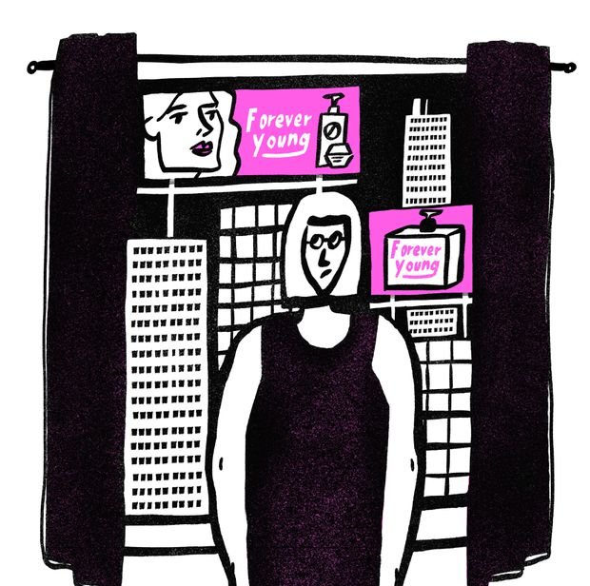
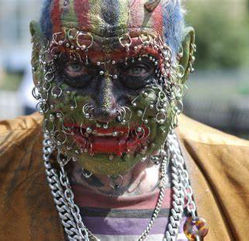
What is body modification?
Definition from Wikipedia
Deliberate altering of human anatomy or physical appearance
Done for aesthetics, sexual enhancement, rites of passage, religious beliefs, display group affiliations, remembrance of lived experience, tradition, etc
Plastic surgery, piercings, tattoo, hair color/styling, tanning, etc
Controversial, objective
Body modification vs self-mutilation
Disfigurement
Consensual vs non-consensual
https://www.theglobeandmail.com/life/first-person/article-why-is-my-body-no-longer-socially-acceptable
https://health.howstuffworks.com/mental-health/can-body-modifications-be-addictive.htm
Notes:
https://health.howstuffworks.com/mental-health/can-body-modifications-be-addictive.htm
https://www.theglobeandmail.com/life/first-person/article-why-is-my-body-no-longer-socially-acceptable/

Slide 4
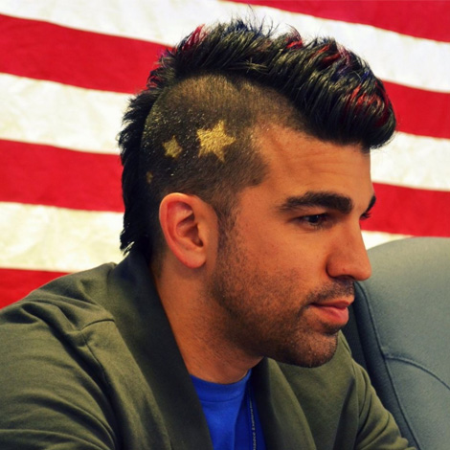
Current trends
Pew-Millenials are the largest generation in the labor force
Pew-up to 40% of millennials are tattooed, not as much information on other modifications
Statistics? Safe to say becoming more popular/accepted
Taking generational differences into consideration can improve recruitment
http://students.egfi-k12.org/nasas-mohawk-guy/
Notes:
https://www.pewsocialtrends.org/2010/02/24/millennials-confident-connected-open-to-change/
http://students.egfi-k12.org/nasas-mohawk-guy/
https://www.pewresearch.org/fact-tank/2018/04/11/millennials-largest-generation-us-labor-force/

Slide 5
What qualities are the prospective workforce looking for in potential employers
Millennials and Gen Z
Millennials want purpose with the paycheck
Gen Z wants money and security
Both want coaches/mentors
Work-life balance
Preference for relaxed dress codes
Notes:
https://articlegateway.com/index.php/JBD/article/view/528/485
https://www.inc.com/ryan-jenkins/how-to-attract-and-retain-millennials-with-the-right-dress-code.html
https://www.forbes.com/sites/christinecomaford/2017/04/22/what-generation-z-wants-from-the-workplace-are-you-ready/#14aa06e053ef

Slide 6
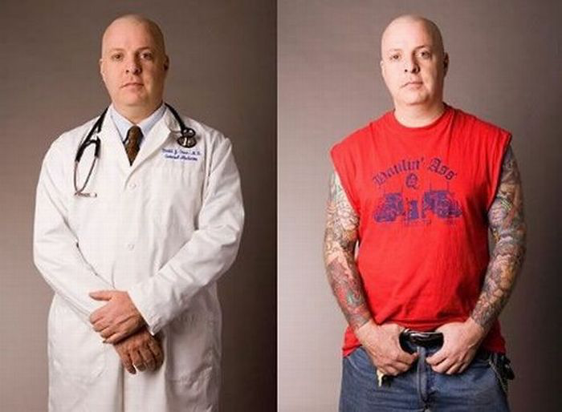
Current policies
Vary by institution
Minimal to extensive and restrictive
Common themes
No to minimal tattoos/piercings
Limiting with hair color/style
Business casual
Scrubs and professional apparel
With any policy, routinely reviewed
References, related policies, and supporting documents?
Most research is on perception, not substantial qualities
Changing!

Slide 7
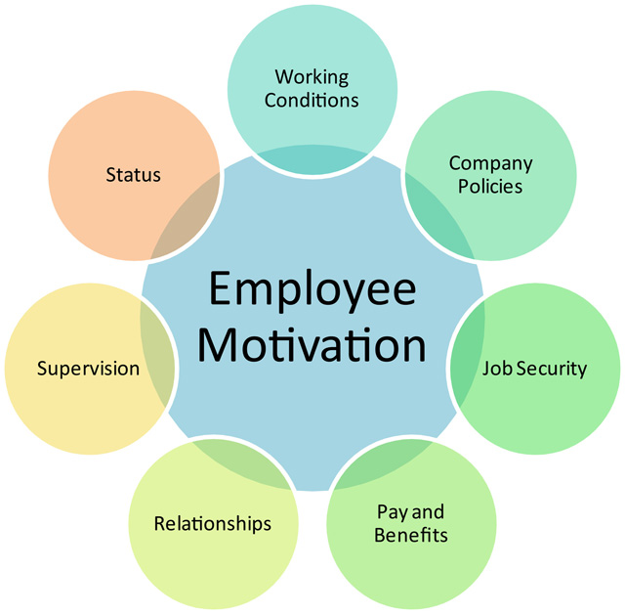
Dress code considerations
Type of clothing
Grooming standards
Examples
Consequences for violation
Regulations and accreditation
Legality
Religion
Sex/gender indentity
Disability
Race
Basic
Hygiene
Identification
Why have a policy and not enforce?
http://www.clipartsuggest.com/employee-handbook-clip-art-TaoLEI-clipart/
Notes:
https://smallbusiness.patriotsoftware.com/company-dress-code-policy-employees/

Slide 8
Proposed policy
https://www.couriermail.com.au/news/national/new-research-shows-patients-ok-with-south-australian-medics-with-tattoos-and-piercings/news-story/362804e2f3864a8aa54e1122060d1484

Slide 9
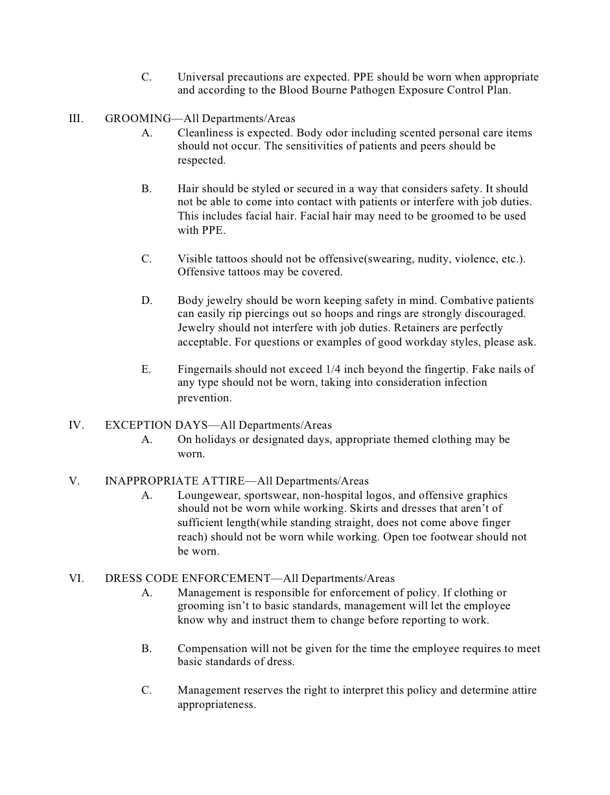
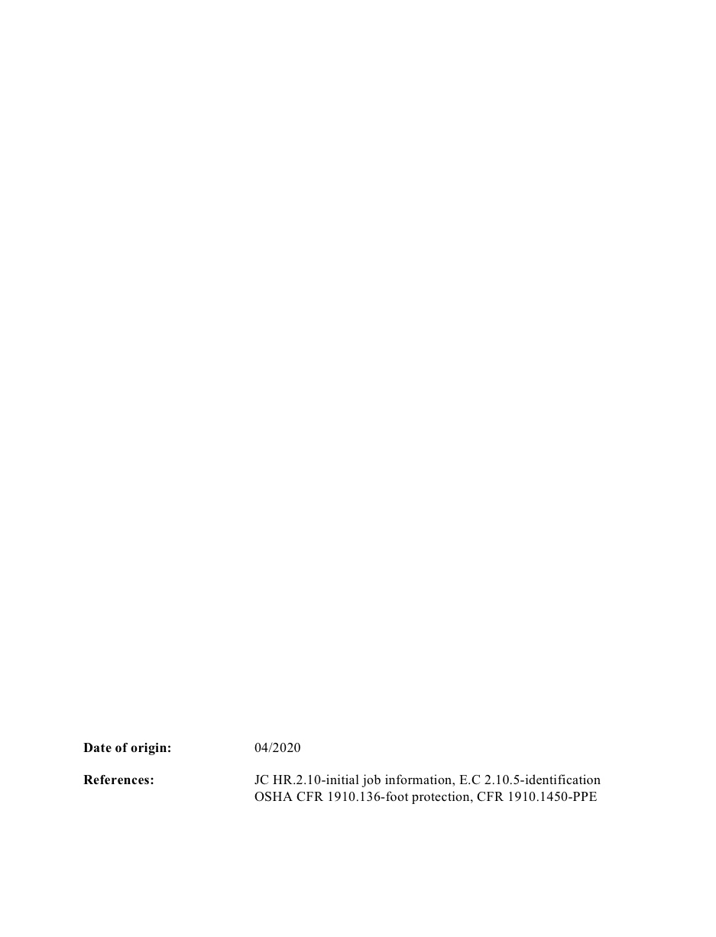

Slide 10
Questions? Comments?

Slide 11
References
https://www.bls.gov/ooh/healthcare/clinical-laboratory-technologists-and-technicians.htm#tab-6
https://www.ascls.org/advocacy-issues/workforce
https://academic.oup.com/ajcp/article/149/5/387/4924356
https://en.wikipedia.org/wiki/Body_modification
https://www.pewsocialtrends.org/2010/02/24/millennials-confident-connected-open-to-change/
https://www.pewresearch.org/fact-tank/2018/04/11/millennials-largest-generation-us-labor-force/
https://articlegateway.com/index.php/JBD/article/view/528/485
https://www.inc.com/ryan-jenkins/how-to-attract-and-retain-millennials-with-the-right-dress-code.html
https://www.forbes.com/sites/christinecomaford/2017/04/22/what-generation-z-wants-from-the-workplace-are-you-ready/#14aa06e053ef
Dress code policies from Benefis Health System, Livingston Health Care, St. Vincent Healthcare, Community Medical Center, North Florida Regional Medical Center, Allina Health
https://link-springer-com.proxybz.lib.montana.edu/article/10.1007/s10672-014-9254-1
https://www.news.com.au/national/south-australia/new-research-shows-patients-ok-with-south-australian-medics-with-tattoos-and-piercings/news-story/362804e2f3864a8aa54e1122060d1484
www.yahoo.com/lifestyle/inked-nurses-tattooed-professionals-can-finally-roll-sleeves-indiana-university-202053851.html
https://www.modernhealthcare.com/article/20171230/NEWS/171239989/mayo-clinic-allows-a-tasteful-show-of-tattoos
https://smallbusiness.patriotsoftware.com/company-dress-code-policy-employees/
https://www.workplacefairness.org/employer-policies

Slide 12
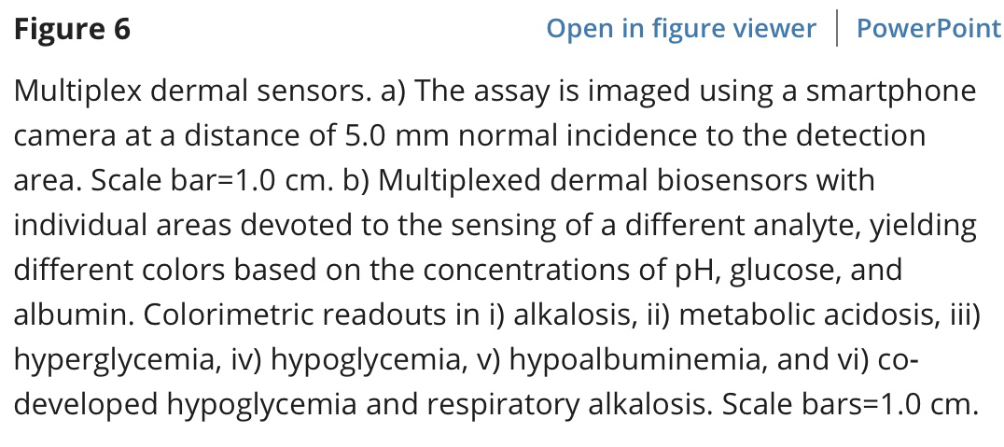
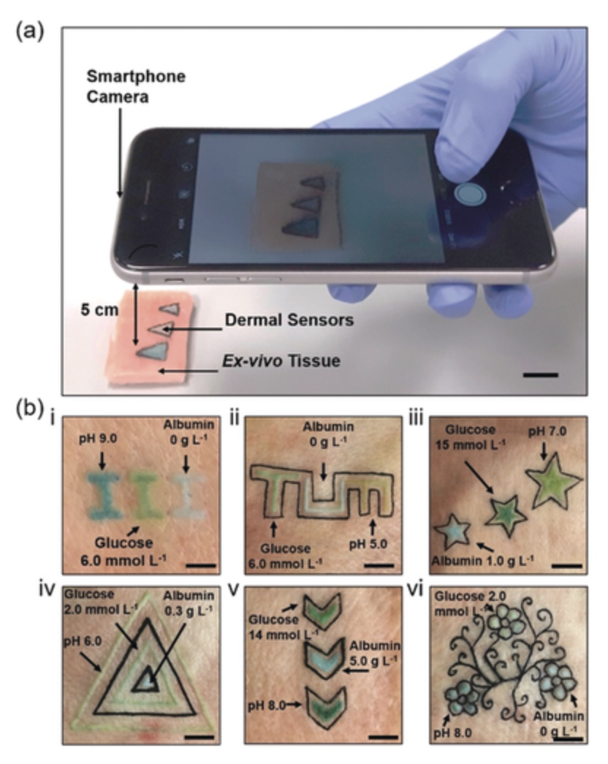
Of interest and curiosity
https://onlinelibrary-wiley-com.proxybz.lib.montana.edu/doi/full/10.1002/anie.201904416

