Slide 1
Acinetobacter baumannaii
A review of Characteristics, Pathogenicity, and Multi-Drug Resistance.
Martina Van Hoy

Slide 2
What are the major characteristics of Acinetobacter baumannii that allow a sustained environmental reservoir (abiotic surfaces and medical devices) resulting in severe and prolonged nosocomial outbreaks?
Flagellar motility and vector transmission
CSU pili and desiccation resistance
Carbapenem-hydrolyzing enzymes and spore formation
Extended periods of latency and asymptomatic carriers
Martina Van Hoy

Slide 3
An Overview
Introduction
Discuss background and significance
Define Acinetobacter baumannii Characteristics
Epidemiology, Pathogenicity, Transmission, and Infections
Multi-Drug Resistance
Conclusions
Future Direction
References

Slide 4
Introduction Acinetobacter baumannii
Small gram negative coccobacillus
Recognized as a nosocomial derived, especially critical care derived infection
Ventilator associated
Opportunistic
Isolated from soil, water, and manure
Acinetobacter Latin for ‘motionless’
Baumannii, paper defining Baumann et al.
Notes:
Can be comm derived (young bronchitis), get from environment animal reserviors
Named paul baumann researched in 1968- Little did baumann know- that the organism would emerge into a significant global threat for prolonged multi-drug resistant outbreaks.- or what one day would become
<⅔ acinetobacter infections a baumannii

Slide 5
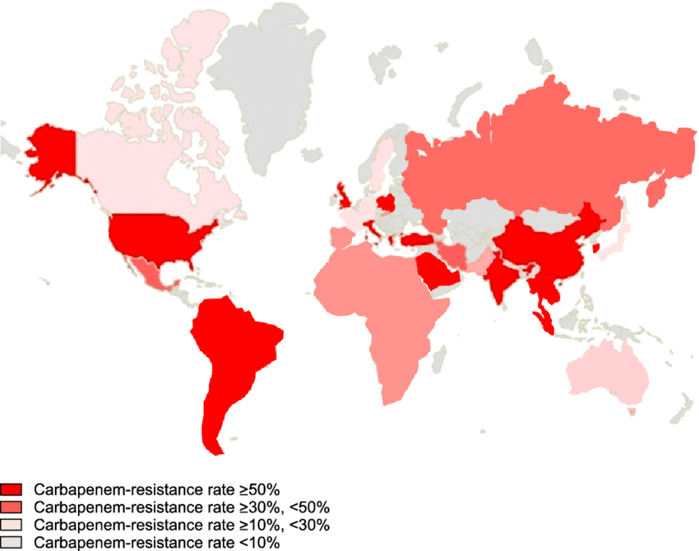
Global Carbapenem Resistance in A. baumannii

Slide 6
Global Outbreaks A. baumannii
Notes:
Red before 2006, yellow since 2006

Slide 7
A.baumannii in the spotlight- Iraqibacter
Cause of significant infections in soldiers both Iraq and Afghanistan conflicts
MDR strain responsible for significant death in Iraqi war
Iraqibacter term- public attention from soldier infections

Slide 8
A.baumannii in the spotlight
Bob Woodruff ABC newscaster survived a bomb in Baghdad before almost sucomming to pneumonia derived sepsis
Infectious outbreaks in hospitals affecting medical personnel and patients that had never seen a battlefield
Characterized multidrug resistant strains from soldiers matching strains from Europe pre Iraqi conflict

Slide 9
Characteristics of Acinetobacter baumannii
Small gram negative coccobacilli
sometimes hard to decolorize
Strict Aerobe
Catalase Positive
Oxidase Negative
Nitrate Negative
Nonfermentative
Frequently in pairs
Notes:
Can appear diplococcal - explains early designation as nicerial species

Slide 10
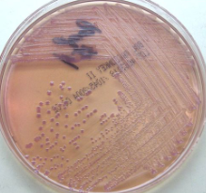
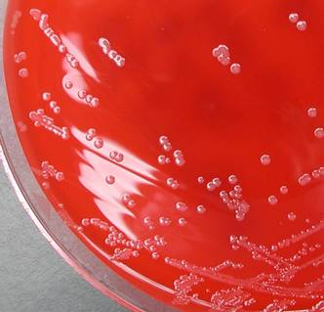
Characteristics of Acinetobacter baumannii
Although A. baumannii is nonfermentative, the strong oxidation of lactose leads to a weakly acidic, or purple color change on MAC agar
Colonies are 1-2 mm and nonpigmented and non-hemolytic on sheep blood agar
Can grow at 44C

Slide 11
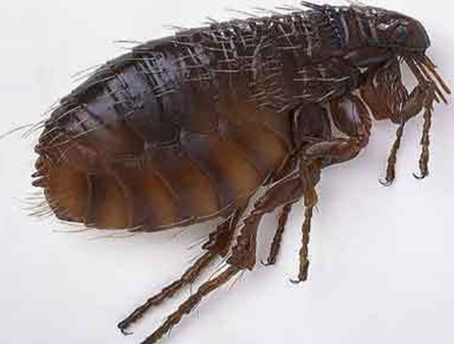
Epidemiology of Acinetobacter baumannii
Environmental sources
Soil
Water
Vegetables
Manure
Reservoirs
Animals
ruminants, fleas, lice, and ticks
Humans

Slide 12
Epidemiology of Acinetobacter baumannii
Hospital Setting
Surfaces
Medical Equipment
Ventilators, dialysis machines etc
Hands
Water
Sinks
Patient Respiratory, Urinary, GI Tract, and Wounds
Notes:
Sinks bedrails doorknobs
Suction equip
Bedding, clothes
Months

Slide 13
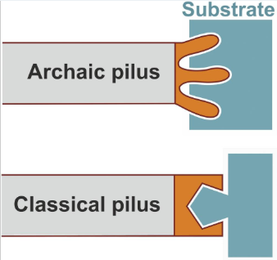
Virulence and Pathogenicity of A. baumannii
Increased conjugation rates result in resistance genes and virulence genes
One study showed evidence of conjugation with Legionella pneumophila
Use of virulence factor associated with Legionnaires disease
Polysaccharide capsule delay phagocytosis, block complement activation
Fimbriae
Pilli- CSU
Apoptosis enducing porin
Biofilm
Notes:
Fimb adhere to bromchial epitheliuym
Pilli biofilm - colonize env surf to biofilm broduction

Slide 14
Infections of A. baumannii
Ventilator-Associated pneumonia
UTI
Sepsis
Meningitis
Wound
Endocarditis
Notes:
Fimb adhere to bromchial epitheliuym
Pilli biofilm - colonize env surf to biofilm broduction

Slide 15
A. baumannii Transmission
Person to Person
Colonized upper respiratory system
Infected person
Environment
Surfaces

Slide 16
A. baumannii Identification
Presumptive Acinetobacter baumannii
Growth at 44C
Colony morphology and gram stain- GNR coccobacilli
Oxidase (-) and Catalase (+)
API 20NE
Rapid One Panel by Remel or API 20 NE strips can Identify to the species level
PCR

Slide 17
Antibiotic Resistance of Acinetobacter baumannii
Acinetobacter baumannii has shown resistance to every class of antibiotics
Drug resistant strains have been isolated from ruminant manure and river sources
Capable of accumulative multiple drug resistance genes
Multi- drug resistant strains
Panresistant strains

Slide 18
Antibiotic Resistance of Acinetobacter baumannii
Mechanisms
Antibiotic modifying enzymes
Reducing outer membrane porin expression
Altered Penicillin-Binding Proteins
DNA gyrase and topoisomerase mutation

Slide 19
Carbapenem Resistance of Acinetobacter baumannii
Metallo-β-Lactamases
Oxa-Carbapenemases
Cell Permeability Changes
Target (PBP) change

Slide 20
Conclusion and Future Direction
Though the current infection risk with Acinetobacter baumannii is low for the healthy community, it is a significant health risk for the immunocompromised and intensive care patients
Prolonged nosocomial outbreaks occur due toA. baumannii ‘s ability to adhere to abiotic surfaces for months in a viable biofilm
The inherent ability of A. baumannii to accumulate both antibiotic resistance genes and virulence genes are due to a high congugation frequency
The primary route of infection is to the lungs via a transient colonization which can result in sepsis.
More research should be completed on the environmental strains which are largely uncharacterized.

