Slide 1
Benefits of Switching to Aliquot Syringes for Neonatal Blood Transfusions
Madison Trent, Montana Medical Laboratory Sciences Program

Slide 2
Objective
After viewing this presentation, participants will be able to summarize the benefits of switching to neonatal transfusion syringes, to both the laboratory and NICU staff.

Slide 3
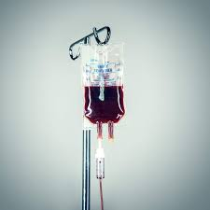
Background
Community Medical Center runs a Level 3 NICU
Neonatal RBC transfusions are performed regularly
Premature infants with low birth weights
Infants with anemia
HDFN
RBC requirements
Group O-
Irradiated
CMV negative (leukocyte reduced)
<7 days old
Hgb S negative
Notes:
Level 3 NICU means they can care for very small and very sick infants
Can take care of premature babies born <32 weeks gestation and less than 1500 grams (3.3 pounds)
22 beds at CMC

Slide 4
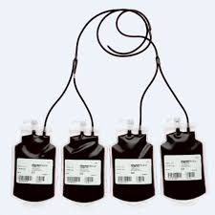
Aliquot Bags
CMC uses Fenwal Transfer Pack Aliquot bags
Bought in cases (48 bags per case)
4 bags come attached as 1 pack
Maintain a closed system within the original unit and aliquot bags
Unit can be used more than once
Notes:
Reason they come in a 4 pack is because you can keep them attached to the original unit and keep aliquoting. You shouldn’t expose neonates to multiple different units because it can cause really bad issues that can end in necrotic bowel syndrome and death.

Slide 5
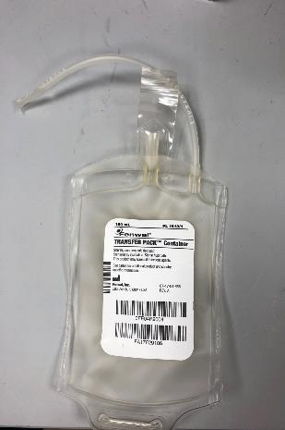
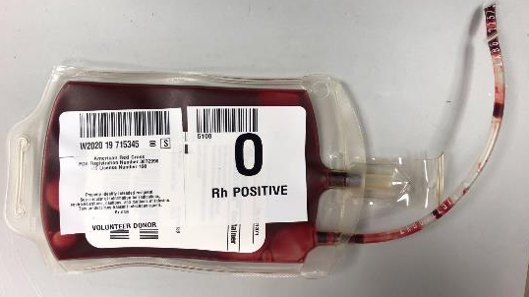
Aliquot Bags
Notes:
TransferPack Aliquot bags

Slide 6
Process of Aliquoting
Find neonatal approved unit and assign it to the patient
allow blood to flow into chosen aliquot bag (add 10 grams to ordered amount)
Seal and separate aliquot bag from original unit
Weld the original unit to transfer pack bag
Hang original unit and clamp off other aliquot units not needed
place aliquot bag on scale and zero the scale
Label aliquot unit
LAB
Perform patient ID and unit checks
Patient vitals
Attach syringe to aliquot and filter blood
Prime IV line
Transfuse
NICU
Notes:
Remember 1gram = 1 ml. This is why we can use a scale to measure

Slide 7
Aliquot Syringes
Aliquot syringes are the same syringes used in the NICU
Used by the NICU to filter the blood before transfusion
Attach to the IV line
Originally thought to have non sterile ports
Would not maintain a closed environment
However they are sterile

Slide 8
Aliquot Syringes
Filter

Slide 9
Syringe process
Attach syringe to original unit
Pull blood with syringe plunger through filter to desired amount
Find approved neonatal unit and assign it to the patient
Label Syringe
Seal and separate syringe from original unit
LAB
Perform patient ID and unit checks
Patient vitals
Prime IV
Transfuse
NICU

Slide 10
Effect on the Lab
Lab now has to perform the pre-transfusion filtering
Aliquot syringes do not need to be weighed- can be directly pulled to desired amount
Less equipment involved
Syringe is directly labeled
Money spent on aliquot bags is saved
Entire step involving bags is completely removed

Slide 11
Effect on the Lab
1 case of aliquot bags: $890
1 pack: $74
1 bag: $18.50
Total amount spent since 2006: $15,130
Money spent per year: $796.31
(on average)

Slide 12
In the NICU
Goal was to understand how this was affecting the NICU
Tracked which patients had received transfusions with syringes (5 infants in total)
Communicated with the NICU staff development coordinator to contact the patient’s nurses
Sent a survey to each nurse about the syringes

Slide 13
NICU Survey

Slide 14
Impressions from the NICU
Positive qualities
5/5 nurses agreed that syringes were faster and saved time
4/5 expressed that they are easier to use
2 nurses said they liked that they were cleaner and produced less waste
Negative qualities
4/5 nurses reported no negative qualities
1 nurse expressed concerns with not being able to agitate the syringe

Slide 15
Final Verdict
Aliquot syringes have had a positive impact on the lab and NICU
Lab: Faster, easier, and cheaper
NICU: Faster, easier, less steps, no longer have to filter blood themselves.

Slide 16
Question
Which of the following best describes how switching to transfusion syringes has improved workflow in the NICU?
A. Transfusions with syringes are decreasing turn around times due to the fact that syringe plungers can be used to speed up the process of filling and infusion.
B. Transfusions with syringes are decreasing turn around times due to pre-filtering occurring in the laboratory and less patient/product checks have to be performed.
C. Transfusions with syringes are not decreased transfusion turn around time, but are more accurate and reliable.
D. Transfusions are occurring at the same rate. No improvements have been seen at this time.

Slide 17
References
Chambers L. A. (1995). Evaluation of a filter-syringe set for preparation of packed cell aliquots for neonatal transfusion. American journal of clinical pathology, 104(3), 253–257. doi:10.1093/ajcp/104.3.253
Strauss, R. G., Crawford, G. F., Elbert, C., Floss, A. M., & Liesch, M. (1986). Sterility and quality of blood dispensed in syringes for infants. Transfusion, 26(2), 163–166. doi:10.1046/j.1537-2995.1986.26286152907.x
NICU. (n.d.). Retrieved March 22, 2020, from http://communitymed.org/areas-of-care/mother-and-baby/nicu

