Slide 1
Clostridium difficile Diagnosis & Detection
Hailey Liss

Slide 2
Gold Standard for Testing C. diff
What is considered the gold standard method of testing for Clostridium difficile?
A) PCR/Nucleic acid amplification test
B) EIA
C) Latex agglutination test
D) Culture

Slide 3
Clostridium difficile
Gram-positive anaerobic bacterium
An opportunistic pathogen that can reside in the gastrointestinal track due to antibiotic use.
There are two types of C. diff, one that carries the toxigenic strain encoded on the gene, and the other nontoxigenic strain without the encoded gene.
The toxins that are associated with the disease are toxin A, a tissue-damaging enterotoxin, and toxin B, a cytotoxin. The toxigenic form of C. diff produces toxin A & B, or only toxin B. Glutamate dehydrogenase, an antigen marker, is produced by both toxigenic and nontoxigenic strains that are markers for an infection with C. diff and together can rule in or rule out the disease.

Slide 4
Increased risk for C. diff infections
Exposure to antibiotics
Age 65 or older
Immunocompromised status
Previous exposure to C. diff.
Antibiotic use due to hospitalization
Colonization/carriers

Slide 5
C. Diff Testing
The variation in all possible choices for C. diff testing have caused confusion for interpretation & the question remains: Colonization or true infection?
Guidelines has been established to help eliminate unnecessary treatment and exposure to antibiotics
The Bristol Stool Chart also helps to determine acceptable specimens for testing.
A minimum of 3 or more unformed stools within 24 hours is also required before testing ensues.

Slide 6
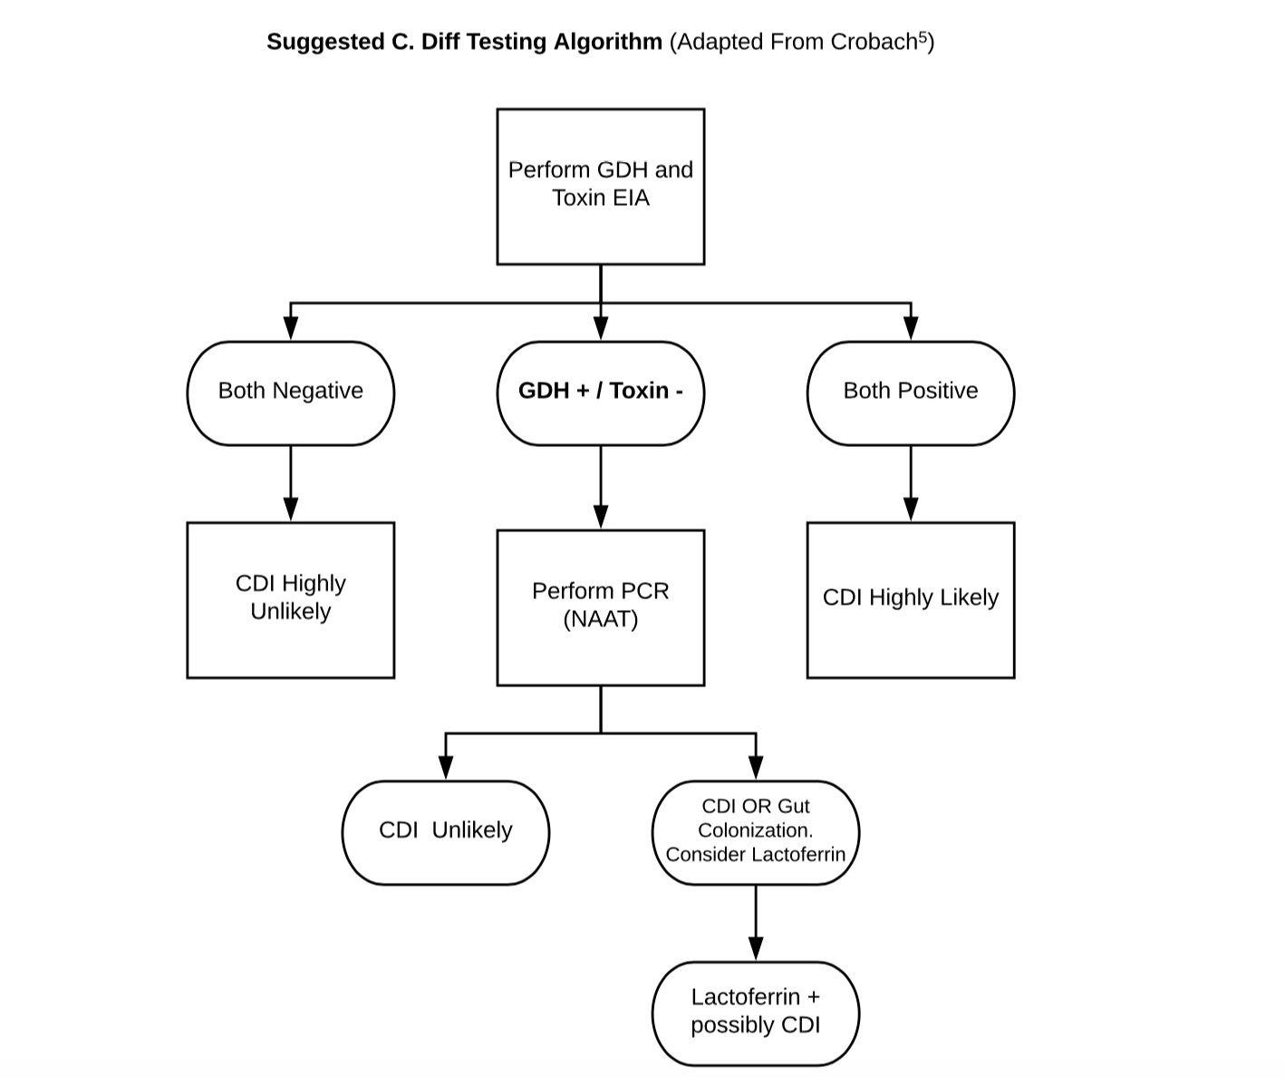
Bristol Chart & Guideline

Slide 7
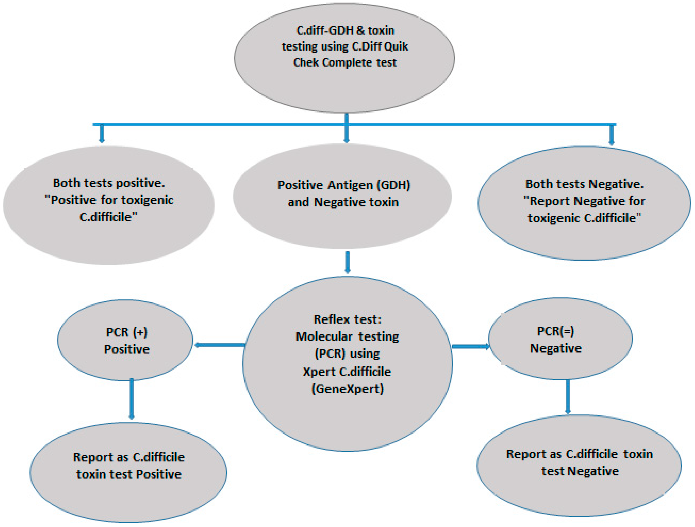
North Valley Hospital
C. Diff Quik Check Complete test
Rapid EIA method
Simultaneously detects GDH (glutamate dehydrogenase) & toxin A/B

Slide 8
Toxin Detection by Culture
Considered “gold standard”
Target: toxigenic & nontoxigenic strains of C. diff
Sensitive, can allow for strain typing in an epidemic
Requires anaerobic culture, isolates have to be tested to toxigenicity
Slow growth: 2-5 days
Toxin detection is critical for CDI
Not used for routine testing

Slide 9
EIA (Enzyme immunoassay)
Target: GDH (glutamate dehydrogenase) and toxin A and/or B
Toxin A and/or B:
Fast (2-6 hours), easy to perform, specific
Not as sensitive as NAAT/PCR
GDH:
Fast (2-6 hours), easy to perform, sensitive
Not specific, positive results need to be confirmed by another assay

Slide 10
PCR/NAAT
More sensitive than toxin EIA and GDH, fast (1-4 hours), easy to perform
Target: genes specific to toxigenic C. diff
Less sensitive than toxin culture
Expensive/concern with detection of colonization & carriers

Slide 11
Testing methods cont.
Toxin testing alone may be sufficient for CDI
Use of only NAAT could lead to over diagnosis & overtreatment
NAAT is important for disease epidemiology and carrier identification
An ultrasensitive toxin detection method does not solve the issue of colonization vs. infection
(?): High levels of toxin = asymptomatic & low levels of toxin = symptomatic
Improvements?: Development of antibody detection tests in combination with pathogen detection as well as ultrasensitive & quantitative methods

Slide 12
References
Bristol stool chart. (n.d.). Retrieved from https://www.continence.org.au/pages/bristol-stool-chart.html
C. diff Diagnosis versus Detection: Why Tests Remain Ambiguous. (n.d.). Retrieved from https://www.asm.org/Articles/2019/January/C-diff-Diagnosis-versus-Detection-Why-Tests-Remain
C. DIFF QUIK CHEK COMPLETE®. (n.d.). Retrieved from https://www.techlab.com/diagnostics/c-difficile/c-diff-quik-chek-complete-30525c-30550c-t30525c-t30550c/
Diagnosis of C. difficile – Why So Difficult? (n.d.). Retrieved from https://www.aacc.org/publications/cln/articles/2018/november/diagnosis-of-c,-d-,-difficile
Narayankar, S. (2018, April 7). Antibiotic associated diarrhea & Clostridium difficile infection. Retrieved from https://www.slideshare.net/SantoshNarayankar/antibiotic-associated-diarrhea-clostridium-difficile-infection
Qutub, Mohammed, Govindan, & Anupama. (2019, January 8). Effectiveness of a Two-Step Testing Algorithm for Reliable and Cost-Effective Detection of Clostridium difficile Infection in a Tertiary Care Hospital in Saudi Arabia. Retrieved from https://www.mdpi.com/2076-3271/7/1/6/htm
Shriki, J. (2018, July 26). C. Diff-(iccile): Should the treatment B. Diff-(erent)? A 2018 Update. Retrieved from https://reviewsinem.com/2018/07/13/c-diff-erens-should-the-treatment-b-diff-erent-a-2018-update/
Yoldas, O., Altindis, M., Cufali, D., Asik, G., & Kesli, R. (2016). A Diagnostic Algorithm for the Detection of Clostridium difficile-Associated Diarrhea. Balkan Medical Journal, 33(1), 80–86. doi: 10.5152/balkanmedj.2015.15159

