Slide 1
Point of Care testing for Lactate
Kaitlin McMahon
Montana Medical Laboratory Science Program

Slide 2
Objective:
To encourage FDA approval on the i-STAT CG4+ cartridge for use as a point of care test in monitoring lactate levels in patients and neonates.
Perform specimen testing to assess correlation, linearity and precision

Slide 3
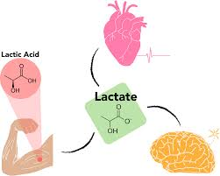
Introduction: What is lactate?
An intermediary in carbohydrate metabolism
Predominantly derived from erythrocytes, brain, white skeletal muscle and renal medulla
Blood lactate levels are dependent on the rate of production and the rate of metabolism in the liver and kidneys
Lactate is removed from the body by oxidation in red skeletal muscle and the renal cortex
Produced in excess when there is decreased oxygen at the cellular level

Slide 4
Introduction: Lactic Acidosis
Serum lactate level above 4 mmol/L
Two clinical settings:
Type A (hypoxic): decreased tissue oxygenation, associated with hypovolemia, left ventricular failure and shock
Type B (metabolic): associated with disease, drugs/toxins or inborn errors of metabolism
Mortality rate > 60%, approaches 100% if hypotension is also present
Most common cause of metabolic acidosis in hospitalized patients
Signs and Symptoms:
Fast shallow breathing
Muscle pain/cramping
Abdominal discomfort
weakness/fatigue

Slide 5
Introduction: When is a lactate test ordered?
Ordered when a patient has signs and symptoms of hypoxia
Healthcare practitioner suspects sepsis, heart attack, kidney failure, severe congestive heart failure or uncontrolled diabetes
Initially ordered with other tests to help evaluate the state of condition
Measured in neonates to assess the adequacy of O2 delivery to tissues

Slide 6
Intro: Why POC?
Neonatologists at Bozeman Health are interested in performing lactate tests
Beneficial to have an at bedside test - common test
Could save time not having to send sample to the lab
Requires less blood to be taken from neonate
Having an accurate beside test would also help other areas of the hospital:
ER patients
ICU patients

Slide 7
Materials and Methods
23 ER patient specimens were analyzed for comparison of in vitro quantification of lactate in venous whole blood.
Samples were first tested on the i-STAT CG4+ cartridge upon arrival to the lab
After results were obtained specimens were tested on the Cobas C502 chemistry analyzer for comparison
All samples were processed as STAT

Slide 8
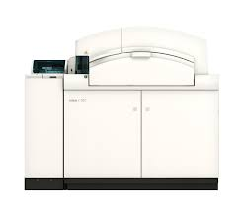
Materials and methods: Cobas C502
Cobas c502 clinical chemistry module
Measures analytes using a photometric assay
Specimens were loaded into the STAT lane of the automation line and transported to the chemistry analyzer

Slide 9
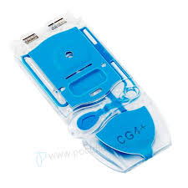
Materials and Methods: i-STAT CG4+
Handheld blood analyzer for Point of Care
Sample type: Arterial, Venous or capillary whole blood
Intended use: in vitro quantification of lactate
Diagnosis and treatment of lactic acidosis
Monitoring tissue hypoxia
Diagnosis of hyperlactatemia
Capable of analyzing pH, PCO2, TCO2, HCO3, PO2, SO2 and base excess

Slide 10
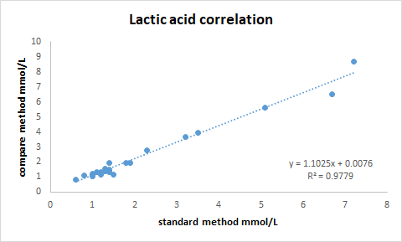
Results: Correlation
Patient samples were analyzed by the i-STAT and Roche methods
Slope = 1.1025
Y intercept = 0.0076
Correlation (r) = 0.9779

Slide 11
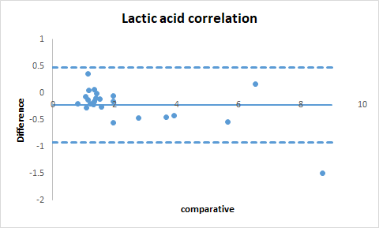
Results: Correlation
Difference (Bland - Altman) Plot
Useful in evaluating if problems occur at certain ranges
Patient #9 had the highest lactic acid concentration - exceeds the lower LoA

Slide 12
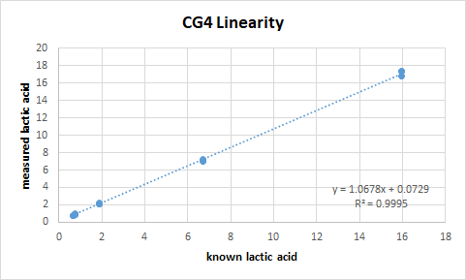
Results: Linearity
5 different levels of lactate concentrations were measured to assess the analytical range of the i-STAT
Slope= 1.0678
Y intercept= 0.0729
Correlation (r) = 0.9995

Slide 13
Results: Precision
RUN | LEVEL 1 | LEVEL 2 | LEVEL 3
1 | 6.71 mmol/L | 1.88 mmol/L | 0.96 mmol/L
2 | 6.75 mmol/L | 1.88 mmol/L | 0.90 mmol/L
3 | 6.78 mmol/L | 2.14 mmol/L | 0.94 mmol/L
4 | 6.71 mmol/L | 2.14 mmol/L | 0.91 mmol/L
5 | 6.78 mmol/L | 2.13 mmol/L | 0.91 mmol/L
MEAN | 6.75 mmol/L | 2.03 mmol/L | 0.92 mmol/L
SD | 0.04 | 0.14 | 0.03
CV | 0.52% | 6.84% | 2.72%

Slide 14
Status on FDA approval:
On 1/15/2020 the i-STAT CG4+ and CHEM8+ cartridges were recalled
Since previously obtaining FDA clearance Abbott modified the white cartridges to introduce a blue cartridge
Changes were observed and did not pursue FDA clearance
No timeline on approval as of right now
FDA and CMS are allowing the use of cartridges in labs/facilities that hold a certificate or accreditation to run tests of moderate complexity during COVID-19

Slide 15
Conclusion:
A method validation study was performed to assess performance of the i-STAT
The CG4+ cartridges showed good diagnostic accuracy, precision and linearity
Bozeman Health and other labs with certification can use the cartridges during the pandemic
Currently looking at other possible options due to failure to pursue FDA approval
Overall was a good experience to become familiar with the process of a method validation

Slide 16
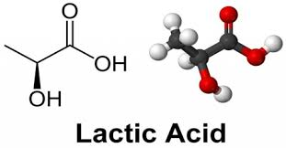
Multiple choice question:
What concentration of serum lactate is indicative of lactic acidosis?
A) 0.5 mmol/L
B) 2.0 mmol/L
C) 3.5 mmol/L
D) 5.0 mmol/L

Slide 17
References:
https://www.pointofcare.abbott/int/en/offerings/istat/istat-test-cartridges/CG4+
https://labtestsonline.org/tests/lactate
https://www.westgard.com/bmv3edfaqs.htm
https://www.westgard.com/lesson23.htm
https://www.accessdata.fda.gov/scripts/cdrh/cfdocs/cfRes/res.cfm?ID=179123
https://www.pointofcare.abbott/us/en/product-letter-CG4+%20and%20G3+
https://www.uofmhealth.org/health-library/hw7871

