Slide 1
Pseudomonas aeruginosa: An Evaluation and Comparison of Antibiotic Susceptibility Methods
Madison Mock
Montana Medical Laboratory Sciences, Montana University System
Spring 2020
Madison.mock@umontana.edu

Slide 2
OBJECTIVES
(1) Evaluate the performance of three methods, one automated and two manual, of antimicrobial susceptibility testing (AST) in a small population with Pseudomonas aeruginosa infections
Automated = Vitek 2 system
Manual = Etest and disk diffusion
(II) Examine validation testing of the Vitek 2 system against piperacillin/tazobactam (PIP/TZP) sensitivity values produced from the Etest and disk diffusion

Slide 3
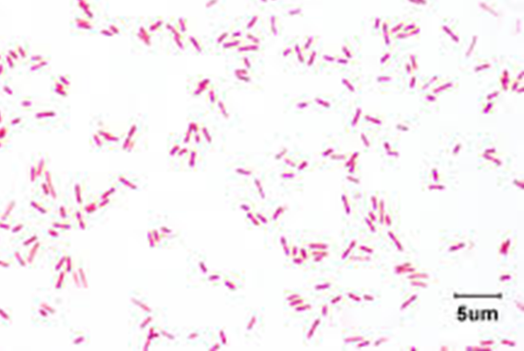
INTRODUCTION
P. aeruginosa (PSA)
Ubiquitous Gram negative coccobacillus
Found in soil, water, plants, and animals (including humans)
A top agent of health care-associated, or nosocomial, infections
Areas of infection occur in burns, blood, eyes, urinary tract, and the lungs
Approx. 51,000 nosocomial P. aeruginosa infections annually in the U.S., 13% are cases due to multidrug-resistance (MDR) isolates (Helio, et al., 2017)
Notes:
Approx. 51,000 nosocomial P. aeruginosa infections are reported annually in the U.S., of which 13% are cases due to multidrug-resistance (MDR) isolates.
PSA poses a therapeutic challenge in that prompt antimicrobial therapy be initiated to optimize clinical outcome.

Slide 4
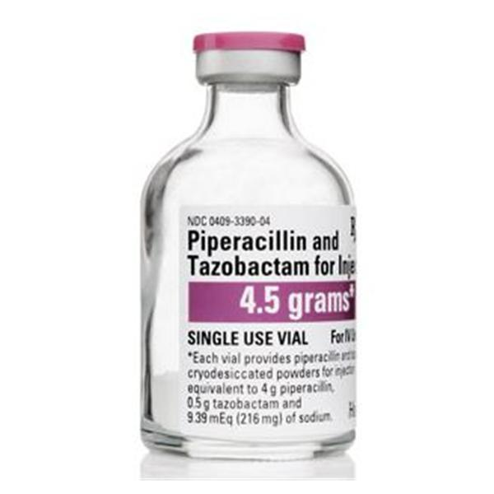
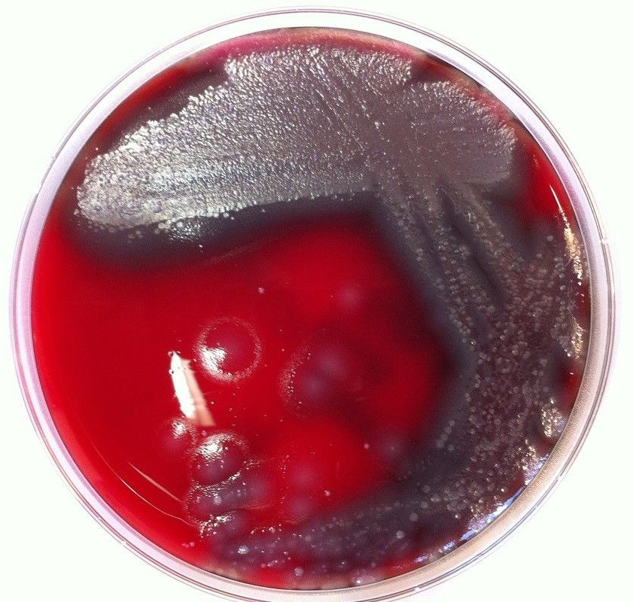
INTRODUCTION (cont.)
Therapeutic challenge – prompt antimicrobial therapy must be initiated to optimize clinical outcome
Piperacillin/tazobactam is a beta-lactam/beta-lactamase inhibitor combination with a broad spectrum of antibacterial activity
Reduce risk of resistance
Inappropriate antimicrobial therapy → increased morbidity and mortality
Notes:
Automated methods, such as the Vitek 2, and manual methods, including the Etest and disk diffusion, of susceptibility testing for P. aeruginosa provide vital information and timely treatment, but present discrepancies when results for piperacillin/tazobactam are evaluated between methods (Saegeman, et al., 2005).
Piperacillin/tazobactam is a beta-lactam/beta-lactamase inhibitor combination with a broad spectrum of antibacterial activity.

Slide 5
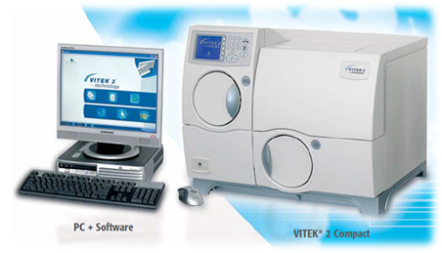
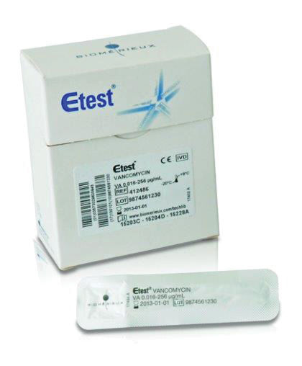
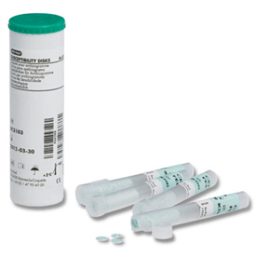
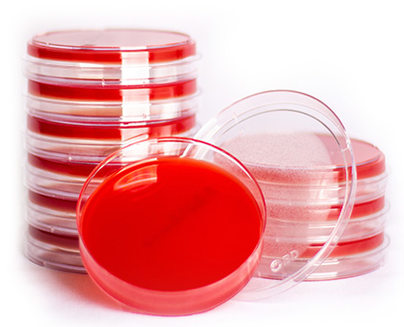
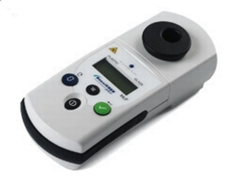
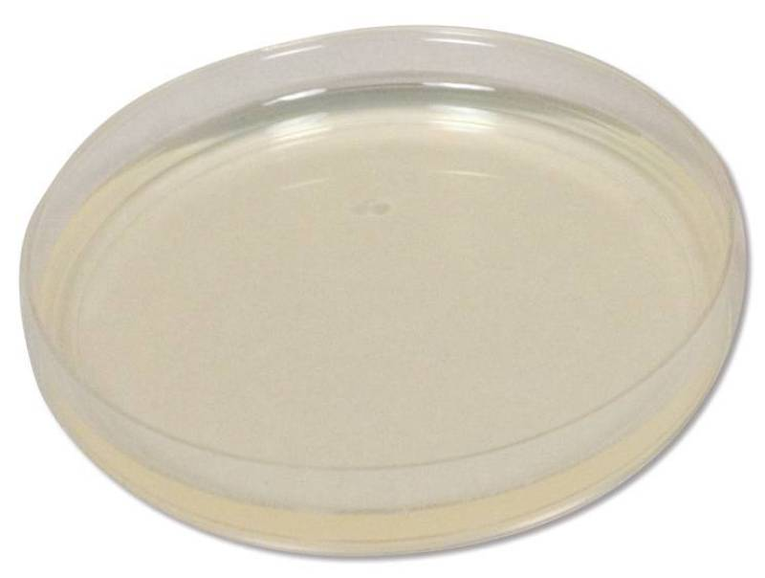
MATERIALS
Tryptic Soy Agar containing 5% sheep blood agar (TSA)
Müller-Hinton (MH) agar
Vitek 2 Compact System
PIP/TZP Etest
PIP/TZP Disk diffusion
Densitometer
Incubator (ambient air, 35°C)

Slide 6
METHODS
Specimen: 18 patients
Specimen subcultured onto TSA plates 24 hours before testing for all three methods
0.5 McFarland standard made for all 3 methods
Vitek 2 – load 0.5 McFarland suspension onto machine with GN80 card to determine the minimum inhibitory concentration (MIC) report
Etest & Disk diffusion – streak out 0.5 McFarland suspension as a lawn onto a Müller-Hinton (MH) agar plate
Place antibiotic disk onto plate, or
Place Etest strip onto plate
Incubate for 18-24 hours in ambient air at 35°C
Disk diffusion - After incubation, zone of inhibition measured to determine specimen sensitivity
Etest – MIC value determined where the inhibition ellipses intersect the strip
Notes:
After obtaining PSA specimen from 18 patients, each specimen was subcultured onto TSA plates so that testing used at most a 24 hour isolate
Specimens were tested using all three methods, to determine their MIC was determined, and were reported as sensitive, intermediate and resistant to PIP/TZP
A 0.50 McFarland standard suspension was made for all three methods
For the Vitek 2 system, a GN80 card was placed in the suspension and loaded onto the machine for testing producing an MIC value
For both the Etest and disk diffusion, the suspension is streaked out as a lawn on a Müller-Hinton (MH) agar plate
Using aseptic technique, antibiotic disks and an Etest strip were placed on each plate using forceps
Incubated for 18-24 hours in ambient air at 35°C
The diameter of the zone of inhibition is measured to determine specimen sensitivity for disk diffusion
The MIC value is determined where the respective inhibition ellipses intersect the strip

Slide 7
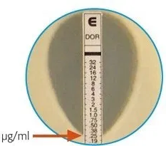
Disk Diffusion and Etest
Figure 1.
Figure 2.

Slide 9
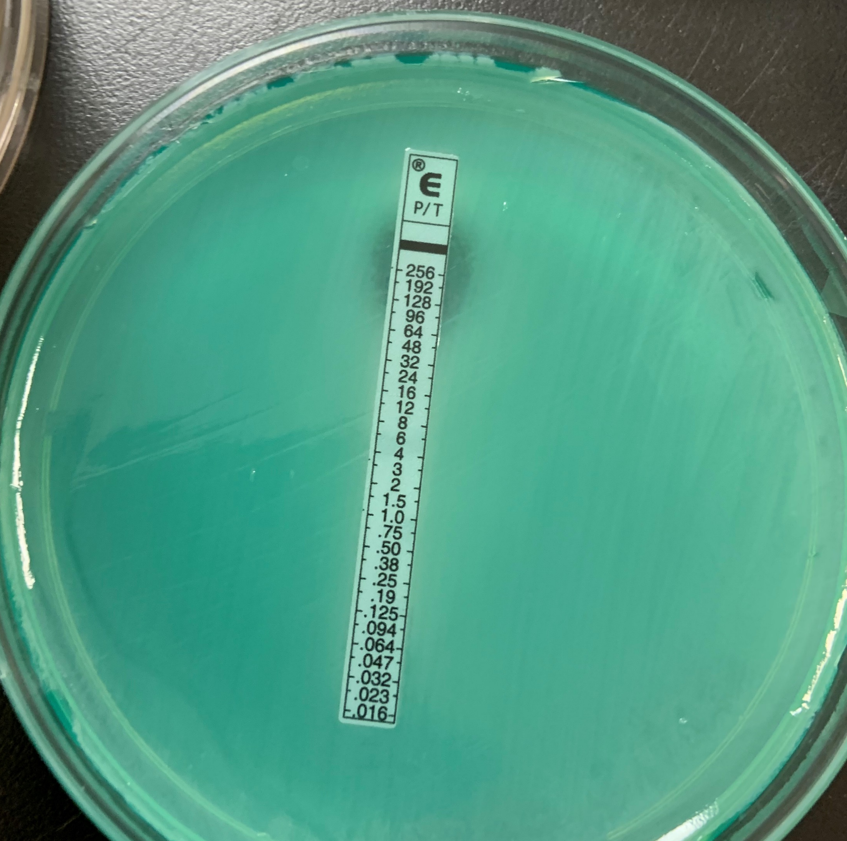
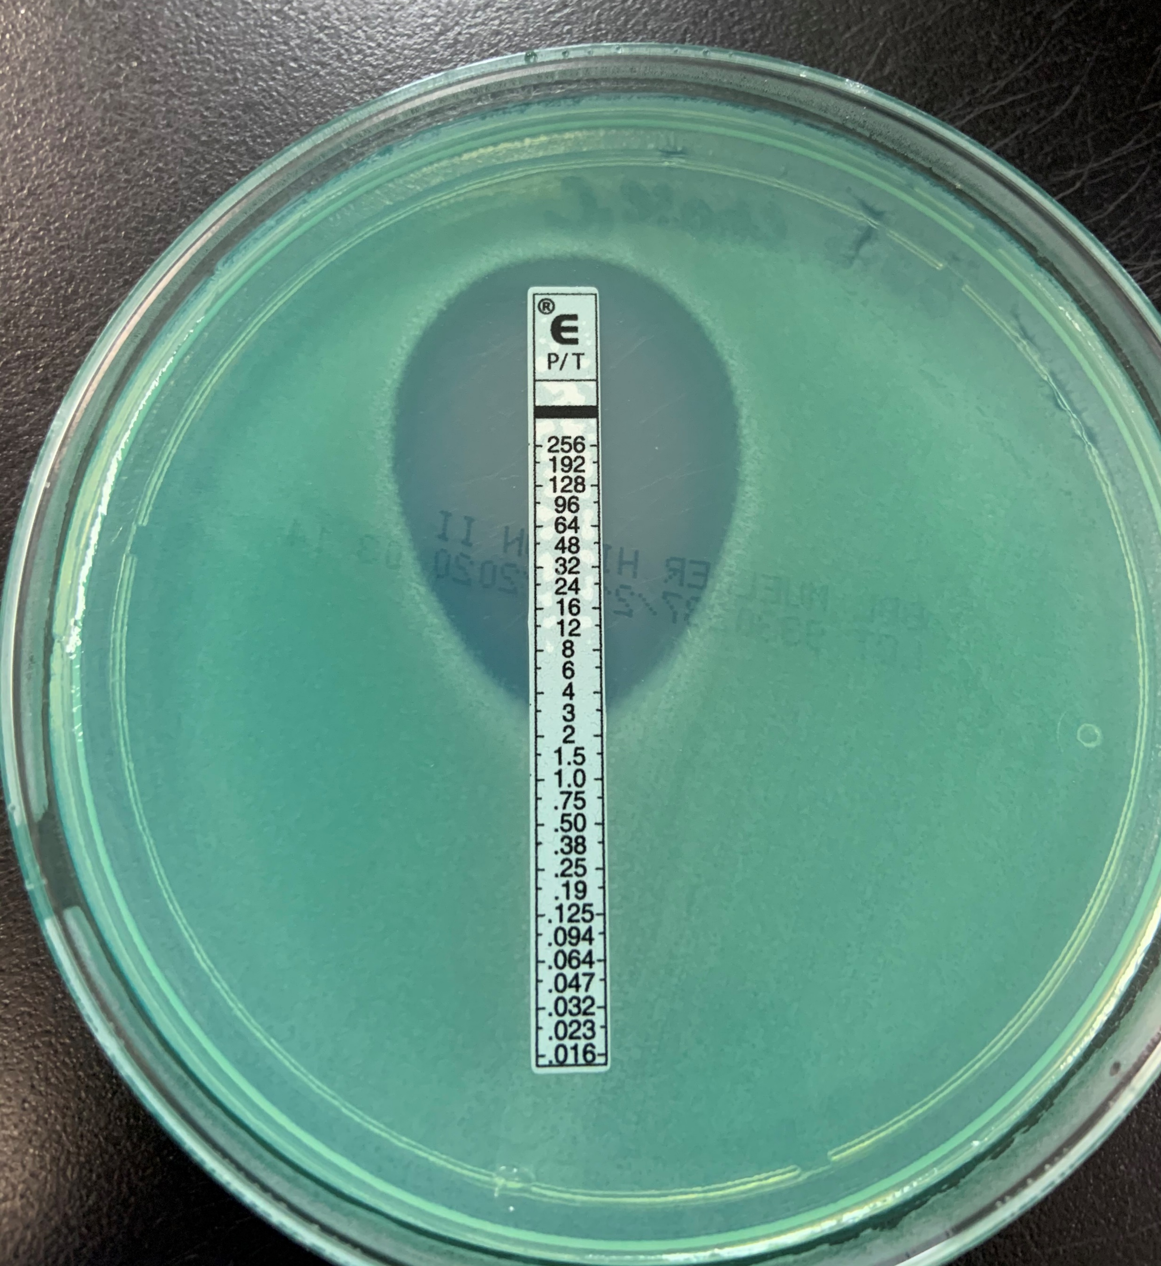
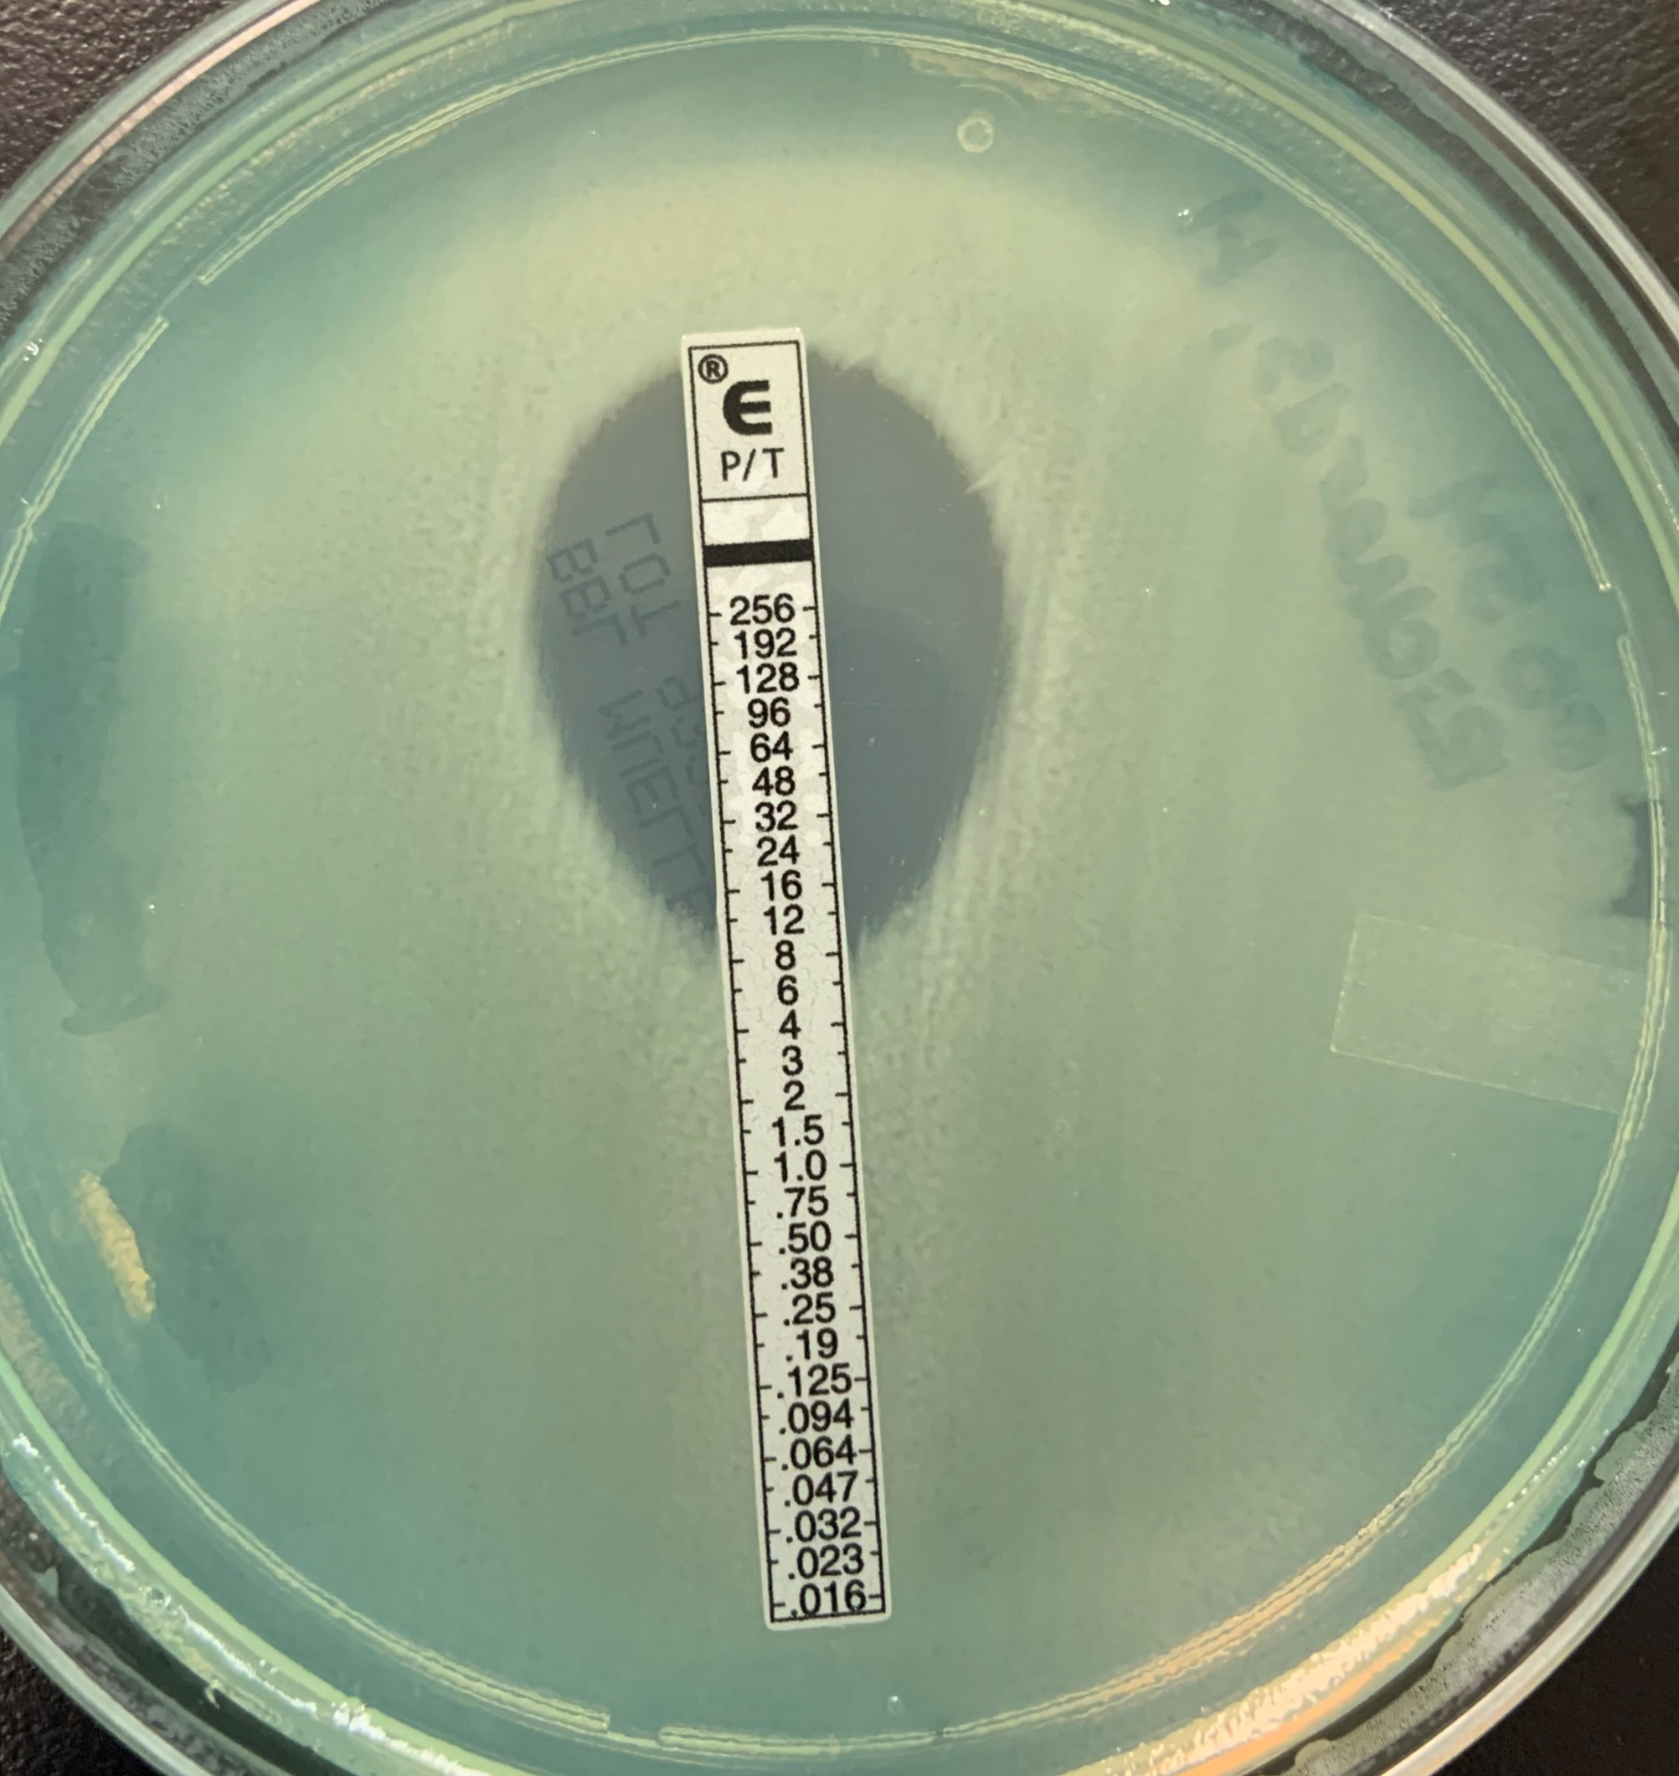
Growth of microcolonies

Slide 10
Results: Comparison of sensitivities for each method
(Figure 4) Etest AST results (Figure 5) Disk diffusion AST results (Figure 6) Vitek AST results
Notes:
The resistance of PSA varied from 72% (with disk diffusion) to 17% (with both VITEK and Etest)
However, both the Etest and VITEK agreed very much if not completely: both the Etest and VITEK had three sensitive results (17% ,17%), 6 and 7 intermediate results (33%, 39%), and 9 and 8 results (50%, 44%), respectively.

Slide 11
(Figure 3) AST of each specimen in relation to each method.
Notes:
These results support the trend that the Etest and disk diffusion method were precise, but the most accurate method was the VITEK 2 System.

Slide 12
CONCLUSION
Agreement between methods showed discrepancies.
When comparing the Vitek and Etest, there was agreement of 78%, Vitek and disk diffusion with 22% agreement, and Etest and disk diffusion with 33% agreement. This means that if labs do not have the Vitek 2 as a resource, the next best method is to use the Etest.
Growing universalization of laboratory automation testing - more clinical laboratories move towards using commercial automated systems for antibiotic susceptibility testing.
Appropriate dosing regimen, MIC determination → selection of antimicrobial therapy.
This study suggests that it is more appropriate to use the Vitek 2 system when evaluating isolates.
In conclusion, these findings emphasize the necessity for continual improvement of instruments, including software upgrades to integration the most up to date antimicrobial breakpoints.
Notes:
With the growing universalization of laboratory automation testing, more and more clinical laboratories move towards using commercial automated systems for antibiotic susceptibility testing. For the most appropriate dosing regimen, MIC determination is vital in that it guides the selection of antimicrobial therapy. This study evaluated the accuracy of commonly used susceptibility testing methods. The results of this study suggest that it is more appropriate to use the VITEK 2 system when evaluating isolates.
This study evaluated the accuracy of commonly used susceptibility testing methods. The results of this study suggest that it is more appropriate to use the VITEK 2 system when evaluating isolates.

Slide 13
MULTIPLE CHOICE QUESTION
Which antibiotic class does Piperacillin/Tazobactam belong to?
B-lactam/beta-lactamase inhibitor
Sulfonamides
Fluoroquinolones
Macrolides
Notes:
ANSWER: (A)

Slide 14
REFERENCES
“CLSI M100-ED30:2020 Performance Standards for Antimicrobial Susceptibility Testing, 30th Edition.” CLSI M100-ED30:2020, 2020, www.em100.edaptivedocs.net/GetDoc.aspx?doc=CLSI%20M100%20ED30:2020&amp;sbssok=CLSI%20M100%20ED30:2020%20TABLE%202B-1&amp;format=HTML&amp;hl=pseudomonas%20aeruginosa
“Disk Diffusion Test and E-Test Methods.” Iknowledge, Raus Respiratory Care Pharmacology, 6 Dec. 2015, www.https://clinicalgate.com/antimicrobial-agents/
Helio S. Sader, Michael D. Huband, Mariana Castanheira, Robert K. Flamm, Antimicrobial Agents and Chemotherapy, Feb 2017, 61 (3) e02252-16; DOI: 10.1128/AAC.02252-16
Perry, Caroline M., and Anthony Markham. “Piperacillin/Tazobactam.” Piperacillin/Tazobactam: An Updated Review of Its Use in the Treatment of Bacterial Infections, vol. 57, no. 5, 22 Oct. 2012, pp. 805–843., DOI:10.2165/00003495-199957050-00017
V. Saegeman, P. Huynen, J. Colaert, P. Melin & J. Verhaegen (2005) SUSCEPTIBILITY TESTING OF PSEUDOMONAS AERUGINOSA BY THE VITEK 2 SYSTEM: A COMPARISON WITH ETEST RESULTS, Acta Clinica Belgica, 60:1, 3-9, DOI: 10.1179/acb.2005.002
Tankeshwar, Acharya. “E-TEST ( Epsilometer Test): Principle, Purpose, Procedure, Results and Interpretations.” Microbe Online, 9 Jan. 2015, www.microbeonline.com/e-test-epsilometer-test-principle-purpose-procedure-results-and-interpretations/
VITEK 2 ™ AST-GN80 [package insert] Part Number 9310682-P1EN1. Marcy, I’Eoile, France: bioMérieux SA; 2015.
ETEST® Piperacillin/Tazobactam (P/T) (0.016/4-256/4 μg/mL) [package insert]. Part Number 050225-01. Marcy, I’Eoile, France: bioMérieux SA; 2019.
Figure 1. “Disk Diffusion Test and E-Test Methods.” Iknowledge, Raus Respiratory Care Pharmacology, 6 Dec. 2015, www.https://clinicalgate.com/antimicrobial-agents/
Figure 2. Tankeshwar, Acharya. “E-TEST ( Epsilometer Test): Principle, Purpose, Procedure, Results and Interpretations.” Microbe Online, 9 Jan. 2015, www.microbeonline.com/e-test-epsilometer-test-principle-purpose-procedure-results-and-interpretations/

Slide 15
ACKNOWLEDGMENTS
Montana MLS Program
The University of Montana, Missoula
Professor Pamela Shaw
St Patrick Hospital & Microbiology Department
Alison Gadbow (Micro Supervisor)

