Slide 1
Artificial oxygen carriers: are they the future?
By: Sawyer Zimmerman

Slide 2
History
Patients with severe injuries have needed blood since the beginning
In 1616, William Harvey discovered how blood was circulated through the body
Injections of sheep blood, urine, milk and even beer were tried as substitutes for blood
1667 the first successful blood transfusions performed
Practice halted due to subsequent transfusions causing death
1854 milk was injected to help with cholera sickness
Patients showed improvement but physicians were skeptical, so they discarded milk as a widespread replacement

Slide 3
History
Karl Landsteiner discovered ABO types in 1901
During WW1, a gum-saline solution developed to help doctors use less plasma. Under the right conditions it was as viscous as whole blood. Discarded in 1930s.
1966 experiments with perfluorochemicals on mice performed. Shown that mice can survive when immersed in PFC.
1968 rats were drained of blood and survived for a few hours with only PFC in them before fully recovering after blood was replaced back into them

Slide 4
History
Vietnam conflict sparked interest into hemoglobin solutions and oxygen carriers
This research was fueled by HIV and Hep C being transmitted through transfusions
Two types of oxygen carriers emerged; perfluorocarbon (PFC) and hemoglobin based

Slide 5
Perfluorocarbons (PFC)
Biologically inert material, inexpensive to make and can be made with no biological materials potentially eliminating the spread of infectious diseases through transfusions
Not water-soluble meaning they need emulsifying agents in order to work
Can dissolve much more oxygen than plasma but carry less oxygen than hemoglobin
Less ability to carry oxygen means you need more PFC, which also means more emulsifying agent
With so much needed for a benefit to be seen, there hasn’t been commercial success with PFC products

Slide 6
Hemoglobin-Based
Natural oxygen carrier that doesn’t need dissolved to bind with oxygen
Without being encapsulated in a membrane hemoglobin can be broken down into toxic compounds that cause damage to the kidneys
Synthetic hemoglobin is produced by a process involving an E. coli strain
The problem with hemoglobin-based is keeping the hemoglobin stable so it isn’t broken down into harmful compounds
No commercial success with hemoglobin-based products

Slide 7
So what happens if the two pathways are combined?

Slide 8
Artificial blood cells
A group of scientists decided to combine perfluorodecalin (FDC), a PFC, and hemoglobin that had the heme molecule removed
Globin is being used as the emulsifying agent for FDC and these particles are coated with red blood cell membrane
This coating of RBC membrane promotes stability and a reduction in glomerulus filtration that will help reduce toxicity of the renal system
These RBCs are called nanoscale RBCs (nnRBCs) due to them being so small (~220nm)

Slide 9
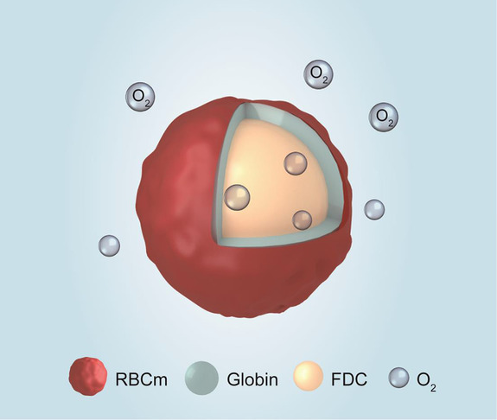
Artificial blood cells
FDC as an extremely high ability to dissolve oxygen
Due to this, nnRBCs can deliver oxygen like a natural RBC
This could be due to FDC having a high drug-loading efficiency
These nnRBCs have high oxygen carrying and slow oxygen release
RBC membrane and heme removal showed no renal toxicity from nnRBCs

Slide 10
Medical purposes
These cells were designed to help make radiotherapy for solid tumors more successful and efficient
The nnRBCs are able to get inside the solid tumor and improve cytotoxicity from the X-ray radiation
They also decreased the effect and helped to reverse the tumor hypoxia
I believe there are further applications that these can be used for….

Slide 11
Potential Medical purposes
The blood shortage in the USA is becoming a bigger issue by the day
In an emergency, these nnRBCs could be used to replace giving packed RBCs
nnRBcs given with plasma and cryo could save a life during a massive transfusion
O negative cells are usually given but with a shortage of blood and people not donating frequently, nnRBCs could carry and deliver oxygen in an emergency

Slide 12
summary
PFC and hemoglobin-based oxygen carriers come with their associated issues but combined could be the advancement we need
Hemoglobin deconstructed so that globin emulsifies perfluorodecalin, covered in RBC membrane, can dissolve, carry and deliver oxygen to reverse hypoxic conditions with a solid tumor
With more research and experimenting we may eventually be able to reduce the pressure we feel with the blood shortage seen throughout the country by being able to implement artificial oxygen carriers into our medical facilities

Slide 13
question
What was the emulsifying agent for perfluorodecalin in the nnRBC?
1) Hemoglobin
2) Bilirubin
3) Globin
4) None of the above
Notes:
Answer is C. Globin

Slide 14
Resources
Sarkar S. (2008). Artificial blood. Indian journal of critical care medicine : peer-reviewed, official publication of Indian Society of Critical Care Medicine, 12(3), 140–144. https://doi.org/10.4103/0972-5229.43685
Yu, P., Han, X., Yin, L., Hui, K., Guo, Y., Yuan, A., Hu, Y. and Wu, J. (2019), Artificial Red Blood Cells Constructed by Replacing Heme with Perfluorodecalin for Hypoxia‐Induced Radioresistance. Adv. Therap., 2: 1900031. doi:10.1002/adtp.201900031

