Slide 1
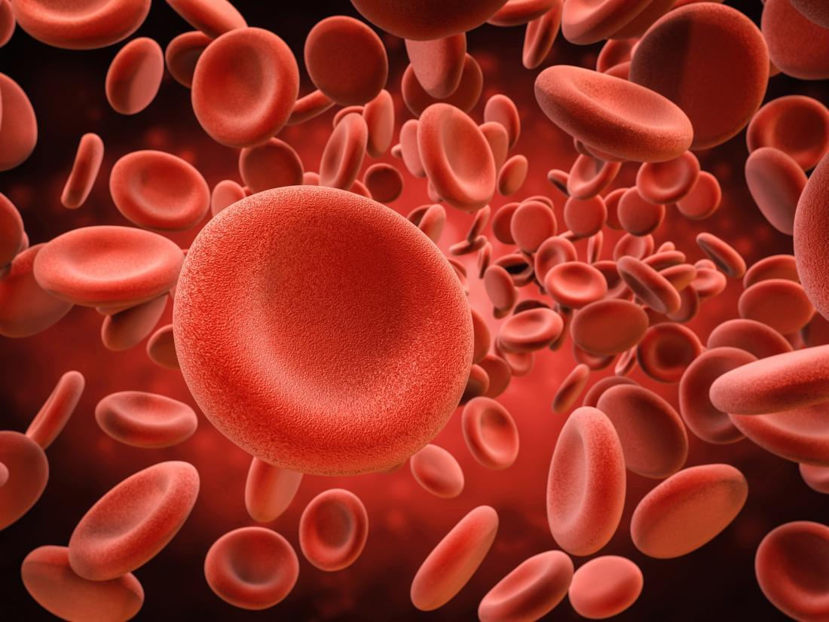
The Mechanisms of Darzalex (Dartumumab) Understanding how the drug, daratumumab commonly known as darzalex, affects blood bank pre-transfusion testing.
Presentation by: Aili baxter

Slide 2
Objectives
Understand what DARZALEX (daratumumab) is, and what it is used for.
Discuss and understand the drug mechanisms of DARZALEX and how it helps the recipient of the drug.
Discuss and understand the how blood compatibility testing is affected by DARZALEX.
Discuss different laboratory available options to mitigate DARZALEX interference with blood compatibility testing in the blood bank.

Slide 3
Introduction: what is Darzalex and what is it used for?
Darzalex is a brand name for the drug Daratumumab.
Darzalex is prescribed as an anti-cancer drug that is given intravenously through injection and is most commonly given to patients diagnosed with multiple myeloma.
Darzalex received official FDA approval as a monotherapy for patients with multiple myeloma, who have already received other types treatments previously, in November of 2015.
Darzalex is not a type of chemotherapy, it is typically given after the use of chemotherapy is used to treat the patient.

Slide 4
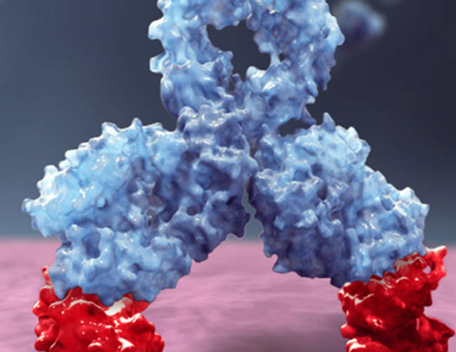
Darzalex: how does it work?
DARZALEX is a monoclonal antibody that targets the CD38 protein found on hematopoietic cells and is overly expressed in patients diagnosed with multiple myeloma.
DARZALEX inhibits tumor cell growth through immune-mediated action, direct on tumor action, and immunoregulatory actions.
After binding to the CD38 protein of myeloma cells, DARZALEX can initiate the complement pathway, mark the cells for phagocytosis by macrophages, and can it can induce cytotoxic affects on the tumor cell to eliminate the cells from the body.
CD38 is expressed on healthy normal cells as well and therefore DARZALEX also influences those cells.

Slide 5
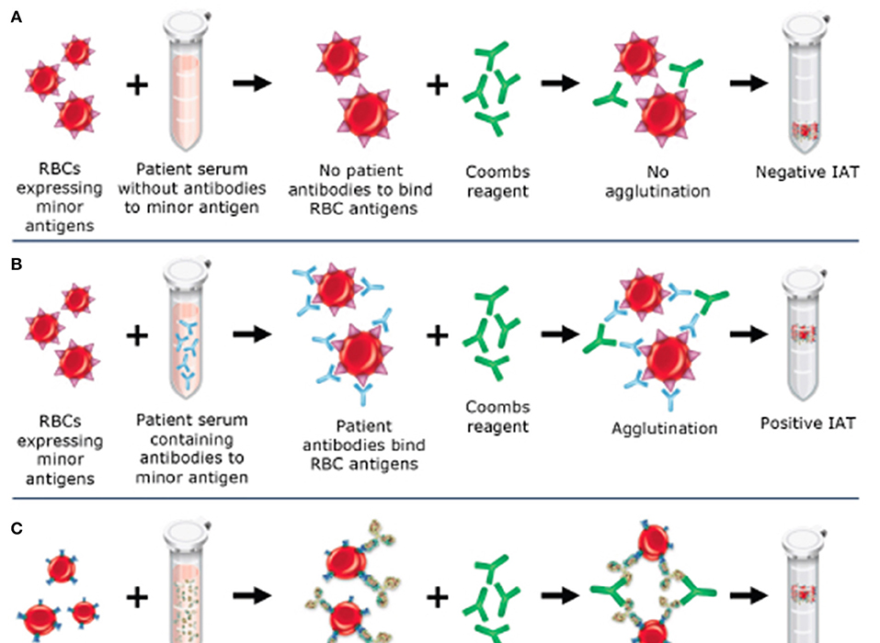
Blood banking with darzalex: how blood bank testing is affected by darzalex
Patients undergoing treatment with DARZALEX are often in need of transfusions. Unfortunately DARZALEX can cause problems with not only the blood compatibility testing but with the transfusion itself.
DARZALEX works by recognizing and binding to the CD38 protein on tumor and healthy cells. This then coats the cells in the monoclonal antibody.
When a patient requires a blood transfusion, an EDTA tube is drawn and the DARZALEX coated cells as well as their plasma which contains free DARZALEX antibodies are then used to type and screen the patient for any lower incidence antibodies that may contribute to a transfusion reaction.
The free DARZALEX monoclonal antibodies will then cause a reaction in the antibody screen, thus giving the MLS in the blood bank a falsely positive reaction

Slide 6
Mitigating the affects of darzalex
Numerous laboratory blood banks and blood donation centers have had to find ways to work around the affects of DARZALEX.
Some blood banks (i.e.. St. Vincent Healthcare Blood Bank) have implemented policies with their cancer treatment centers that initiated blood compatibility testing before the patient has received their dosage of DARZALEX.
Other blood banks and donation centers use various testing procedures to mitigate the affects of DARZALEX on the IAT run on the patients' sample after they have received the treatment.

Slide 7
Testing before darzalex is given: Phenotyping
Testing after darzalex is given: DTT TREATMENT
Materials:
Patient’s blood sample in an EDTA tube, drawn before the patient has received any DARZALEX
Centrifuge
Small (6mL) glass test tubes
Disposable plastic pipettes
Heat Block (37 degrees Clesius)
Blood Bank magnifying lamp
Monoconal Antibody reagent
Consisting of the most common groups known to cause transfusion reaction. (i.e.. Rh antigen group antibodies, Duffy antigen group antibodies, Kidd antigen group antibodies ect..)
Materials:
Donor packed red cells sample
Centrifuge
Cell saline wash
Small (6mL) glass test tubes
Disposable plastic pipettes
Heat block (37 degrees Celsius)
DTT

Slide 8
How each method works to mitigate DARAZLEX
When a patients’ red blood cells are antigenically phenotyped prior to their infusion of DARZALEX, the blood bank now can order blood units that phenotypically match the patients red cells. This will ensure that the patient is receiving blood products that are safe to transfuse.
DTT treatment of a patients red blood cells works to mitigate the effects of DARZALEX by denaturing the CD38 protein on the surface of the cells. Once the CD38 protein has been removed the monoclonal antibodies of DARZALEX have nothing to bind to, so when the patients’ plasma is added the only reaction that should occur is one between an antigen on the donors’ red cells and antibodies in the patients’ plasma.

Slide 9
Disadvantages of both procedures
The biggest disadvantage when it comes to phenotyping the red cell antigens of a patient before they begin their DARZALEX treatment is that it takes an incredible amount of time. Since the procedure involves following the insert procedures for each monoclonal antibody reagent, and testing all of them against the patients’ red blood cells, this method could take a blood banker away from other test for a while. Another big disadvantage is the cost of reagents. Some of the monoclonal antibody reagents can be up to $1,000 for just one vial.
The disadvantage of using the DTT method is that it can also denature the Kell (K) antigen. Although the method is much quicker than phenotyping it alters the donors’ antigens and could lead to a possible transfusion reaction.

Slide 10
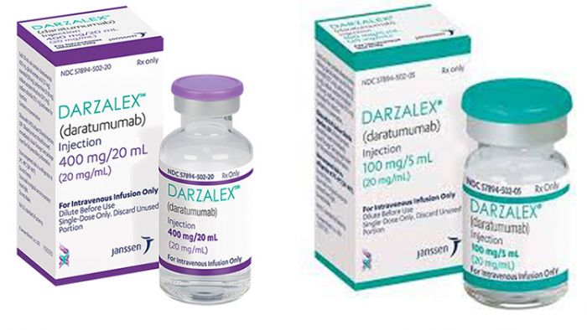
Conclusions
DARZALEX is a drug treatment that has been shown to help aid in the improvement of multiple myeloma in numerous patients.
Although it can be difficult and tricky to navigate, there are methods to mitigate the effects of DARZALEX in patients who require a transfusion.
Phenotyping the patients red blood cell antigens prior to them receiving DARZALEX, and then giving them phenotypically matched blood is a tedious method, but it can help ensure a safe transfusion for the patient.
DTT treatment of the patient’s red blood cells is a resourceful method that can save the blood bank/donation center time when preparing blood product for a DARZALEX patient, but it also has its disadvantages.
As laboratorians and blood bankers it is our responsibility to the safety of the patient to do everything on our part to ensure that they receive to correct blood products, no matter the extra time it may take us.

Slide 11
References
Barrientos-Soto, M., Castañeda-García, M., Herrera-García, A., Padilla-López, S., Dimas-Adame, M., & Cazares-Tamez, R. (2017). The use of DTT in the resolution of the interferences generated by daratumumab in the blood bank. Medicina Universitaria, 19(76), 127–130. doi: 10.1016/j.rmu.2017.07.006
DARZALEX® (daratumumab) Mechanisms of Action. (2019, November 20). Retrieved from https://www.darzalexhcp.com/mechanisms-of-action
Dizon, M. F. (2016). The Challenges of Daratumumab in Transfusion Medicine. Laboratory Medicine, 48(1), 6–9. doi: 10.1093/labmed/lmw055
Sapatnekar, S., & Figueroa, P. I. (2014). How do we use molecular red blood cell antigen typing to supplement pretransfusion testing? Transfusion, 54(6), 1452–1458. doi: 10.1111/trf.12623

