Slide 1
Pan Genera Detection Test
(PGD Test)
Bridget Bollinger
Billings Clinic and Montana State University

Slide 2
ABSTRACT
Platelet shelf life has been a continuous problem surrounded with controversy for many years. Now, with the FDA presumptively planning to decrease platelet shelf life from five days to three days hospitals and blood suppliers are researching, planning and preparing ways to safely extend platelet shelf life. The decreased shelf life will have a detrimental impact on not only supply and demand, but costs to patients, hospitals and blood suppliers if a solution is not implemented before the FDA deadline of March 2021.
Billings Clinic is just one facility preparing to overcome this hurdle. They are currently preparing to start a one to three-month study and possible implementation of the Verax Pan Genera Detection (PGD) test, which is currently FDA approved and proven to detect bacterial contamination to confirm that the platelets are safe for transfusion. With Verax PGD, laboratories will be able to test apheresis bags of platelets that are suspended in 100% plasma and clear them for possible use up to 7 days. However, hospitals are still required to validate the test along with writing a Standard Operating Procedure (SOP) before using Verax PGD test.

Slide 3
At the conclusion of this presentation, participants will understand how the upcoming change from the FDA of shortening of platelet storage will affect hospitals and blood suppliers around the country and how introducing the Pan Genera Detection (PGD) test can help eliminate some of burden until other options become available and approved.
OBJECTIVE

Slide 4
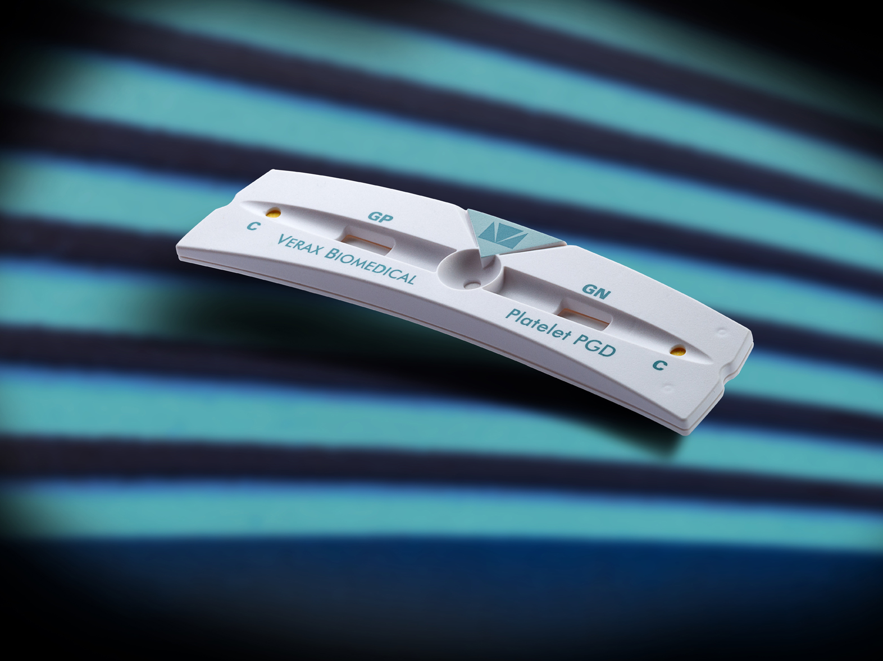
Introduction
The Verax Biomedical Platelet Pan Genera Detection (PGD) Test is a rapid, qualitative immunoassay for the detection of aerobic and anaerobic Gram-positive and Gram-negative bacteria in platelet components.
It is the only day of transfusion test for extending the expiration date of Apheresis platelets in 100% plasma for up to seven days when using containers cleared by the FDA for 7-day testing.
The PGD test also helps to assure the safety of 5-day dated platelets for transfusion. An Apheresis platelet my be transfusion for up to 24 hours after a non-reactive PGD test results.

Slide 6
Capture line of
Immobilized
LPS Antibodies
Terminal Wick
Impregnated with a pH
Sensitive dye
Conjugate pad w/
Colloidal Gold labeled
LPS antibodies

Slide 7
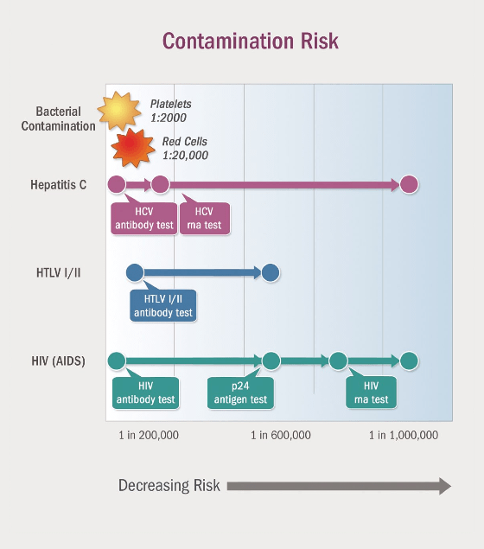
Bacterial contaminants in platelets and red blood cells represent the greatest lethal infectious risk in transfusion medicine today
Over 17 million patients receive in excess of 60 million units of these individual blood components annually in North America, Europe and Asia, and each of these components is at risk for bacterial contamination.
The risk of transmission of HIV per blood unit transfused has now been reduced to well below 1 in 1,467,000
The risk of being transfused a bacterially contaminated blood component is estimated by transfusion medicine experts to be 1 in 2,000 to 1 in 20,000 for platelets and red cell
12,000 bacterially contaminated blood components may be transfused every year representing the single greatest source of fatalities attributable to infectious agents in transfusion medicine today
Notes:
Enormous commitments of time and effort over the past 20 years have resulted in a dramatic reduction in the transmission of viruses through blood transfusion. For example, the risk of transmission of HIV per blood unit transfused has now been reduced to well below 1 in 1,467,000¹. In contrast, the risk of being transfused a bacterially contaminated blood component is estimated by transfusion medicine experts to be 1 in 2,000 to 1 in 20,000 for platelets and red cells, respectively. This means that as many as 12,000 bacterially contaminated blood components may be transfused every year representing the single greatest source of fatalities attributable to infectious agents in transfusion medicine today. In recognition of this risk, the American Association of Blood Banks implemented a standard requiring all of its members implement methods to limit and detect bacterial contamination in platelets.

Slide 8
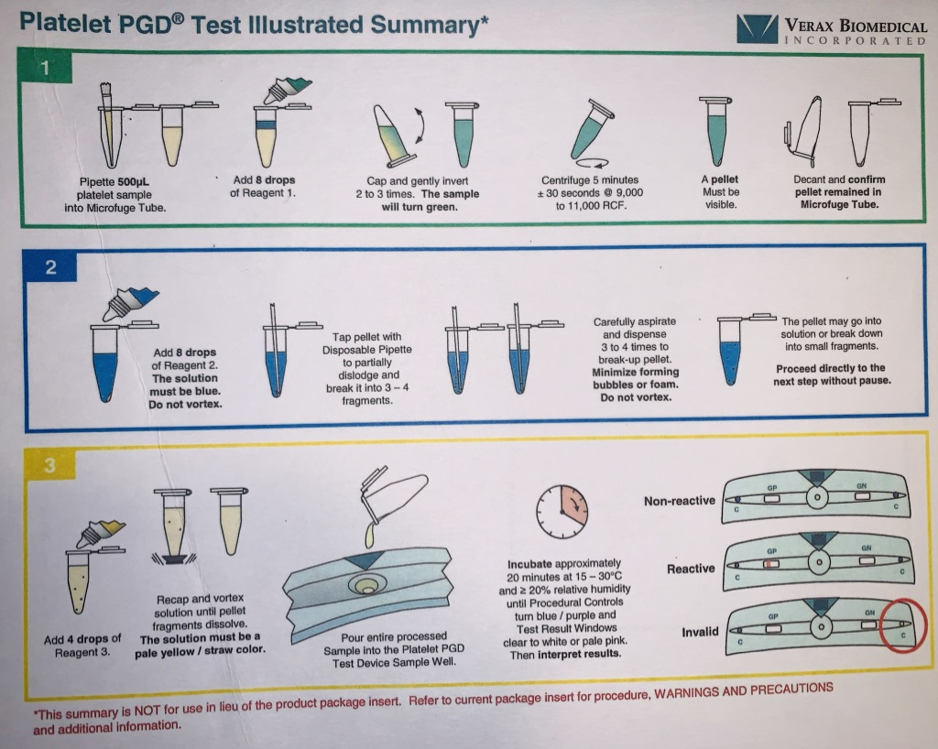
Broad detection — only one test to detect aerobic and anaerobic bacteria
Sensitive — Detected 9 culture false negative units in a population of 27,620 apheresis platelets
99.9% specificity — based on the repeat reactive rate in LRAP units
Rapid results — 1 test in 30 minutes, a batch of 12 in less than a 1 hour
Ease of use — < 3 minutes of attended labor for one test, < 15 minutes for a batch of 12
Small sample size — only 500 uL
No dedicated instrument required — simple visual results
Built in procedural controls — confirm sample addition and test completion

Slide 9
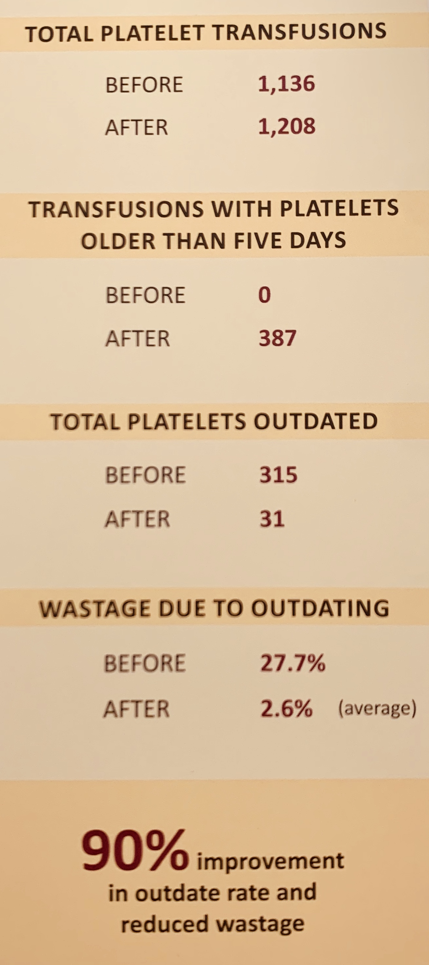
WELLSPAN HEALTH
Cost Savings
580-bed community teaching hospital
1200+ Physicians and advanced practice clinicians
15,000 employees
6 hospitals
140 locations
Receives 95% of Platelet supply through its onsite blood donor center

Slide 10
Knowledge Test
What is the number one infectious risk associated with transfusion of platelets products?
Hemolytic Transfusion Reactions (HTR)
Allergic reactions ranging from hives to severe anaphylaxis
Transfusion Related Acute Lung Injury (TRALI)
Bacterial Contamination
Notes:
Enormous commitments of time and effort over the past 20 years have resulted in a dramatic reduction in the transmission of viruses through blood transfusion. For example, the risk of transmission of HIV per blood unit transfused has now been reduced to well below 1 in 1,467,000¹. In contrast, the risk of being transfused a bacterially contaminated blood component is estimated by transfusion medicine experts to be 1 in 2,000 to 1 in 20,000 for platelets and red cells, respectively. This means that as many as 12,000 bacterially contaminated blood components may be transfused every year representing the single greatest source of fatalities attributable to infectious agents in transfusion medicine today. In recognition of this risk, the American Association of Blood Banks implemented a standard requiring all of its members implement methods to limit and detect bacterial contamination in platelets.

Slide 11
QUESTIONs?
Verax Biomedical. (n.d.). Platelet PGD (Pan Genera Detection) System. Retrieved from https://www.veraxbiomedical.com/approach/risk/
Notes:
Enormous commitments of time and effort over the past 20 years have resulted in a dramatic reduction in the transmission of viruses through blood transfusion. For example, the risk of transmission of HIV per blood unit transfused has now been reduced to well below 1 in 1,467,000¹. In contrast, the risk of being transfused a bacterially contaminated blood component is estimated by transfusion medicine experts to be 1 in 2,000 to 1 in 20,000 for platelets and red cells, respectively. This means that as many as 12,000 bacterially contaminated blood components may be transfused every year representing the single greatest source of fatalities attributable to infectious agents in transfusion medicine today. In recognition of this risk, the American Association of Blood Banks implemented a standard requiring all of its members implement methods to limit and detect bacterial contamination in platelets.

