Slide 1
Investigation into rising syphilis cases and diagnostic method changes
Taylor Grogan
Montana Medical Laboratory Science Program

Slide 2
Introduction
Background on syphilis
Method verification and validation
Background and explanation of syphilis testing
Why the switch in methods
Is syphilis on the rise?

Slide 3
Syphilis background
Treponema pallidum subspecies pallidum is the causative agent
Sexually transmitted disease, usually
Potential to be transmitted through the placenta
Three phases of disease
Darkfield micrograph of Treponema pallidum [photograph]. Retrieved from: https://www.cdc.gov/std/syphilis/images/darkfield-1.jpg

Slide 4
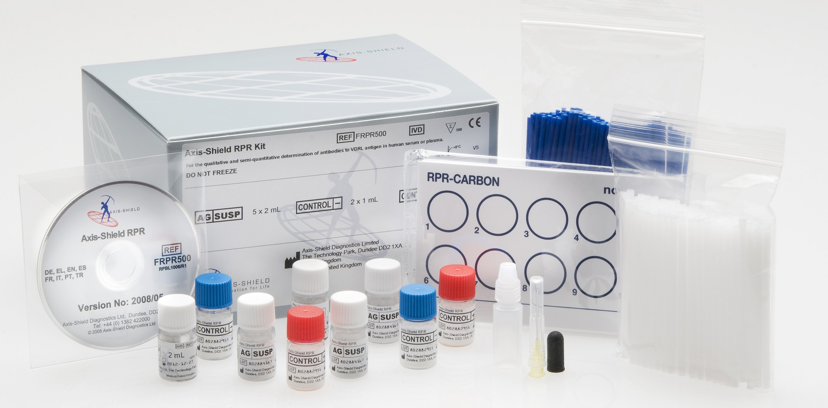
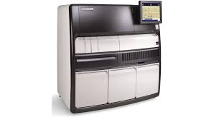
Method verification/validation background
RPR test kit [photograph]. Retrieved from: https://www.axis-shield.com/syphscreen-rpr/#
Verification – establishes that the functioning limits of the test are satisfactory
Validation – ongoing process that offers evidence that the test is executing correctly
DiaSorin Liaison XL [photograph]. Retrieved from: https://www.diasorin.com/en/immunodiagnostic-solutions/systems/clia-systems/liaisonr-xl

Slide 5
Overview of syphilis testing methods

Slide 6
Why methodology changed
Benefis switched from RPR to total antibodies directed against T. pallidum
Reverse testing algorithm
Serological testing, in conjunction with clinical presentation can establish the phase of disease
An issue of sensitivity and specificity

Slide 7
Syphilis is on the rise

Slide 8
Results
All results spanning from April 20th 2019 through December 31st 2019
58 positives
63 negatives
4 equivocal

Slide 9
Conclusions
The new method was implemented correctly
Syphilis numbers are increasing in our population, and the CDC has backed that up
More people could be getting tested than before
Different testing algorithms may be detecting infection better

Slide 10
References
Centers for Disease Control and Prevention. Syphilis – CDC Fact Sheet (Detailed). Retrieved from: https://www.cdc.gov/std/syphilis/stdfact-syphilis-detailed.htm
DiaSorin (2016). Liaison Treponema Assay (REF 310480). DiaSorin. 1-13
Lehman D. C., Mahon C. R. (2019). Textbook of Diagnostic Microbiology, Sixth Edition. Elsevier. 524-526, 911-914.
Mayo Clinic Laboratories. Test ID: SYPHT Syphilis Total Antibody with Reflex, Serum. Retrieved from: https://www.mayocliniclabs.com/test-catalog/Clinical+and+Interpretive/603259

