Slide 1
Creating a mic guide
By: Sarah Sanchez

Slide 2
motivations
Disconnect between MLS and care providers when MICs are being reported out
Working with Dr. Stevens, one of the infectious disease doctors at Benefis
Expand my own knowledge on MICs
Notes:
At my clinical site, the students were approached by our microbiology lead about possibly creating a minimum inhibition concentration guide for care providers at Benefis. Myself, being a slight procrastinator still did not have a project, so I jumped at the opportunity. I was intrigued by this project because (1) there can be miscommunication between the lab and care providers so by creating this guide it lessens this gap (2) I got to work with Dr. Stevens, an infectious disease doctor which a was a great way to network and expand my knowledge on MICs and antibiotics.
Dr. Stevens had been wanting to create a quick reference guide for quite some time now but has never been able to tackle the project herself. She had been noticing that some care providers were having trouble interpreting the MICs that the lab was reporting out and maybe not making the necessary connections to provide the best treatment for the patient.

Slide 3
Objective of project
Create a guide that assesses minimum inhibition concentrations and how MICs correlate with clinical breakpoints, aiding in selection of antibacterial agents for various infections.
Notes:
The main purpose of this quick guide to provide the background knowledge of MICs. The topics covered include: how MICs and breakpoints are established, do MICs matter for antibiotic penetration, Can MICs be compared within an antibiotic class/ between antibiotic classes?, and how MIC data is used to select antibiotics appropriately.

Slide 4
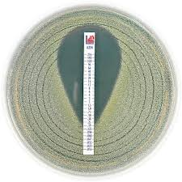
Background knowledge
What is an MIC?
What is a breakpoint?
How are these established?
https://encrypted-tbn0.gstatic.com/images?q=tbn%3AANd9GcSM-Iez0zQDwGjCJPPMLmn03ppq9pj9cfkbI9aBTVT8KV2TPVtn&usqp=CAU
Notes:
This guide explains basic concepts like what a MIC is and how breakpoints are established.

Slide 5
How are MICs established?
Clinical and Laboratory Standards Institute and FDA
Antibiotic penetration into bodily tissues
Free/unbound drug available for antibacterial activity
Notes:
It also explains how MICs are determined by the Clinical and Laboratory Standards Institute along with the FDA. Another aspect that Dr. Stevens wanted to address was antibiotic penetration into different bodily tissues. One of the bigger PK factors is that only free/unbound of the drug is available for antibacterial activity. So, that concentration that is free is the amount that can penetrate bodily tissues.

Slide 6
Comparing MICs
Class representative concept
Generalize interpretive categories within an antibiotic class, not MIC
Generalize SIR between antibiotic class =
Notes:
Another topic covered was if MICs can be compared within an antibiotic or between antibiotic classes. The class representative concept of testing presumes that when an organism is susceptible or resistant that other members of the same class should also be either susceptible or resistant. The biggest point to take away from this is that it is only appropriate to generalize the interpretive category within the antibiotic class, NOT the MIC. This is due to the various potencies among compounds within the same antibiotic class. Comparing MICs between antibiotic classes is not allowed due to their various modes of action and potencies.

Slide 7
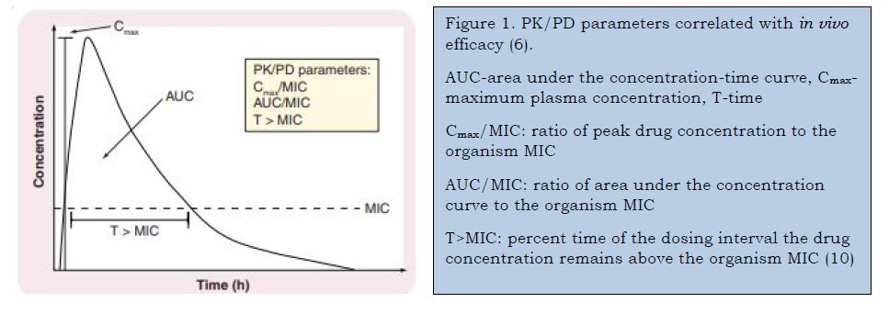
How are MICs used to select antibiotics appropriately?
Interpretive Categories (SIR)
Concentration dependent killing vs time-dependent killing
Category 1
Category 2
Notes:
The two categories that antibiotics are divided into are concentration-dependent killing that has prolonged persistent effects and time-dependant killing that has minimally to moderately persistent effects.
Category 1 introduces a higher concentration for a more rapid and extensive degree of bacterial killing. This achieves longer lasting and persistent effects that allows for infrequent dosing.
Category 2 has a saturation of the killing rate at low multiples of the MIC. So higher concentrations do not kill the organism any faster than lower concentrations. The therapeutic goal for these antibiotics is to optimize the duration of exposure while maintaining serum levels above the MIC.

Slide 8
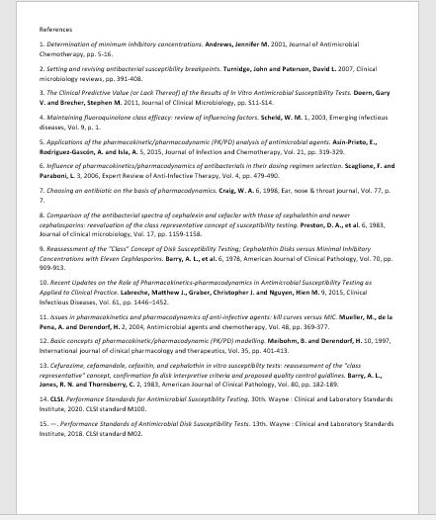

Slide 9
In conclusion
Understanding how MICs are used to help select the appropriate antibiotic for an infection.
Lessening the gap between the laboratory and other healthcare departments.
Getting the opportunity to work with Dr. Stevens, Dr. Geyer, and the pharmacy department.
Notes:
In conclusion I hope that this guide helps for anyone really understand how MICs are used to select the appropriate antibiotic. One of the goals of this project is was to help lessen the miscommunication between the laboratory and other healthcare departments, ultimately providing the best care for the patient. My favorite part of this project was getting the opportunity to work with Dr. Stevens along with Dr. Geyer and the pharmacy department. This will be published on the Benefis intraweb allowing for anyone at Benefis to access this information.

