Slide 1
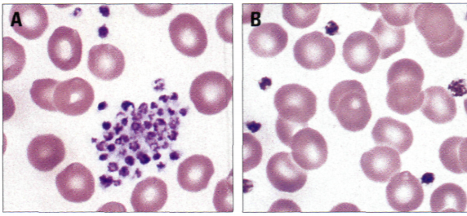
Vortexing and Specimen Integrity in the Hematology Lab
Benjamin Phalen
GFC Hospital

Slide 2
Introduction
Platelet clumping is a frequent problem encountered in the Hematology lab. It causes a phenomenon known as pseudothrombocytopenia, which can lead to erroneous CBC results being reported out.
This clumping can be caused by traumatic blood draws, prolonged blood draws, auto-antibodies to the preservative EDTA, or platelet cold agglutinins.
Not only can pseudothrombocytopenia cause erroneous results but it can also cause unnecessary slide reviews and patients having to be called back and redrawn.
To increase laboratory turnaround time and overall patient satisfaction, a common and documented method used in the lab is to vortex the specimen and disaggregate the platelet clumps.

Slide 3
But what effect, if any, does vigorously mixing the specimen have on the individual blood components?

Slide 4
Objective
I wanted to investigate if vortexing compromises the integrity of the original specimen collected and in what ways.
To achieve this, 30 random patient samples were analyzed pre-vortex and post-vortex using the Beckman Coulter DXH800.
The five indices of importance in this study will be WBC’s, RBC’s, Hgb, Plt’s and RDW.

Slide 5
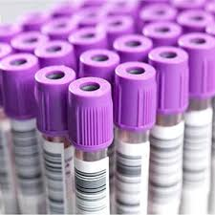
Materials
30 random patient blood samples in lavender top (EDTA) tubes.
ABBOTT Laboratories Vortexer. Model # - AB1A3201 (120 volts, 0.5 amps, 60 Hz).
Beckman Coulter DXH800 Heme Analyzer.

Slide 6
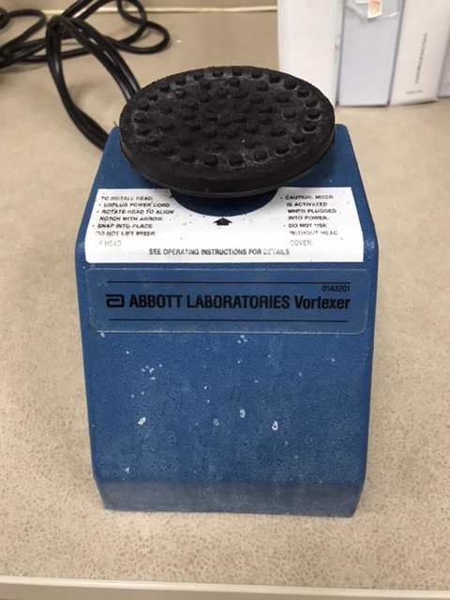
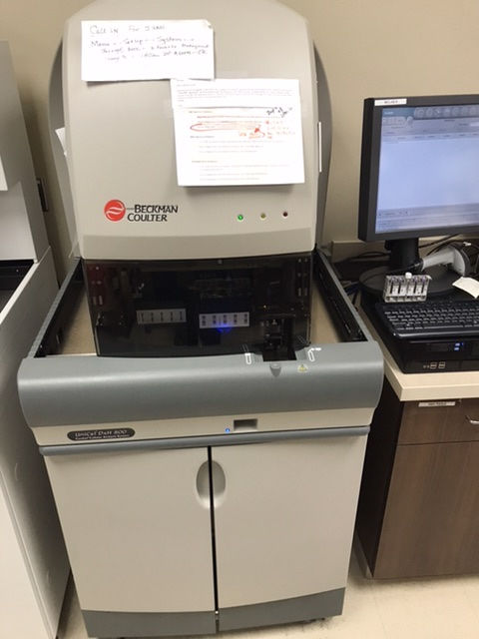
Materials

Slide 7
Methods
30 random patient samples were collected and analyzed using the Beckman Coulter DXH800.
Those 30 random samples were then vortexed for exactly 30 seconds each.
The individual specimens were then put back on the DXH800 and analyzed a second time.
CBC results of the pre-vortexed and post-vortexed specimens were then compared and checked for any significant differences.

Slide 8
Results
 | WBC's |  |  | RBC's |  |  | HGB |  |  | PLT's |  |  | RDW
 | Pre-Vortex | Post-Vortex |  | Pre-Vortex | Post-Vortex |  | Pre-Vortex | Post-Vortex |  | Pre-Vortex | Post-Vortex |  | Pre-Vortex | Post-Vortex
Mean | 7.90 | 7.93 |  | 4.41 | 4.42 |  | 13.23 | 13.26 |  | 255.13 | 261.37 |  | 15.59 | 15.64
S.D. | 4.10 | 4.11 |  | 0.62 | 0.62 |  | 1.64 | 1.67 |  | 106.43 | 110.16 |  | 3.65 | 3.58

Slide 9
Conclusion
After compiling and comparing the data from the 30 random patient samples, it was determined that no significant changes were seen between pre- and post-vortexed CBC results.
Based on the data collected, one can assume that vortexing does not compromise the integrity of the original specimen.

Slide 10
Acknowledgements
This research was made possible by the Great Falls Clinic Hospital.
Thank you to everyone who supported me during my research!

Slide 11
References
Correction of Platelet Count Using a Vortex in Pseudothrombocytopenia. (2003). Annals of Laboratory Medicine. Retrieved from http://www.annlabmed.org/journal/view.html?uid=1549&vmd=Full.
Gulati, Gene L., PhD, SH(ASCP)DLM, Asselta, Amy, MS, MT(ASCP)SH, Chen, Conrad , H(ASCP). Using a Vortex To Disaggregate Platelet Clumps. (2018). Hematology. Retrieved from https://watermark.silverchair.com/labmed28-0665.pdf.
Tvedten, Harold dvm, PhD, Korcal, David bsmt, ascp. Vortex Mixing of Feline Blood to Disaggregate Platelet Clumps. (2008). Veterinary Clinical Pathology. Retrieved from https://onlinelibrary.wiley.com/doi/abs/10.1111/j.1939-165X.2001.tb00416.x.

