Slide 1
Onboarding validation of High- Sensitivity Troponin I on Siemens Atellica Solutions and performing method comparison to Cardiac Troponin I (cTNI) assay on Siemens Vista 1500 and i-STAT point of care device
Megan Perry, Montana Medical Lab Science Program, Billings Clinic

Slide 2
Abstract
Troponin is a group of proteins that is part of the muscle fibers; it’s comprised of troponin C, troponin T, and troponin I. In 2020 Billings Clinic brought in High- sensitivity Troponin I [1] (hs-cTnI) testing on Siemens Atellica to replace the Cardiac troponin I assay performed on Siemens Vista 1500. The new hs-cTnI assay allows physicians to diagnose Myocardial Infarction within 2-3 hours of serial testing of the assay compared to 3-6 hours over cTnI assay. The validation of hs-cTnI assay at Billings Clinic included verification of linearity using MCM materials, assay accuracy, and method comparison against troponin assay (cTnI) on Siemens Vista 1500 and i-STAT POC devices. The new hs-cTnI allows for broader and more sex-specific based reference ranges compared to the overall reference range used with cTnI assay. The 99th percentile cut-off recommended by Siemens was used as a reference interval for the new assay. Due to the highly sensitive nature of this test, 3 levels of known QC materials were used for the new assay. The ongoing phase of implementation is to educate physicians about the significant changes that will be seen with the new assay; for example, their units will now be reported in whole numbers compared to decimal points for cTnI assay.
Key words: troponin, Atellica, validation.

Slide 3
Objective and Question
Objective:
Lab and clinical staff will know the differences in the new reporting values of the Atellica IM High- sensitivity Troponin I compared to the Simmons Vista.
Question:
What is the IFCC recommended Unit of Measure for reporting the new High- sensitivity Troponin I assay?
Whole numbers (ng/dL)
Whole numbers (ng/mL or pg/mL)
Decimal points with (ug/mL)
Decimal points with (ng/mL)

Slide 4
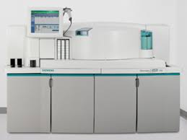
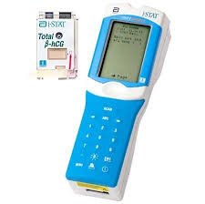
Sandwich chemiluminescent immunoassay
Immunoassay

Slide 5
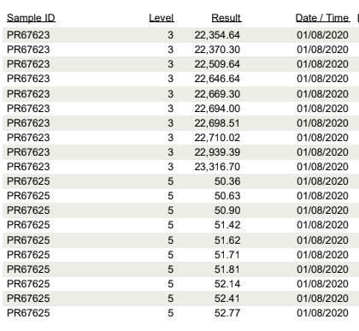
Repeatability
The method’s ability to produce similar test results for multiple runs of the same sample.

Slide 6
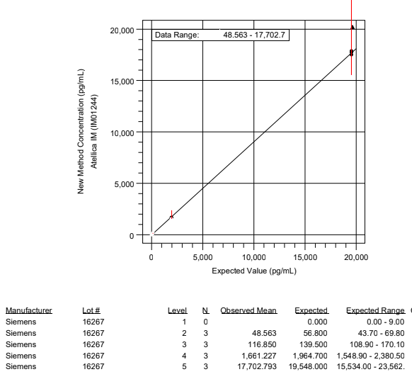
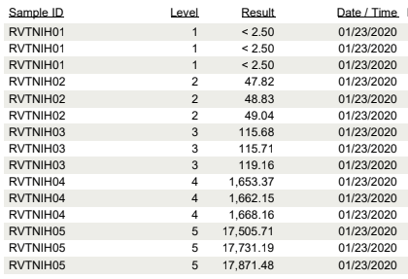
Reportable Range
The span of test result values over which the laboratory can establish or verify the accuracy of the instrument or test system measurement response.

Slide 7
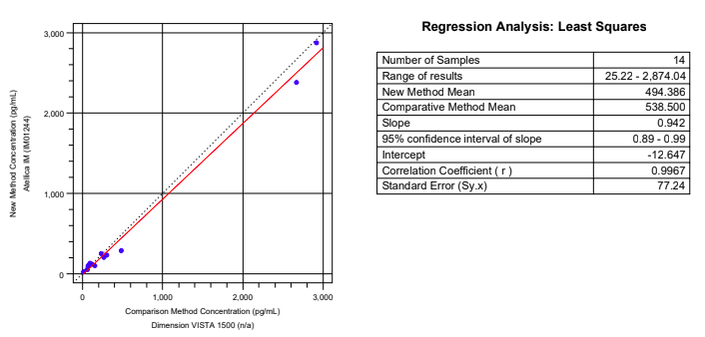
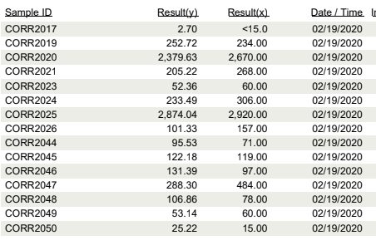
Method Comparison
A comparison of how closely the measured values of the two different methods agree with one another.

Slide 8
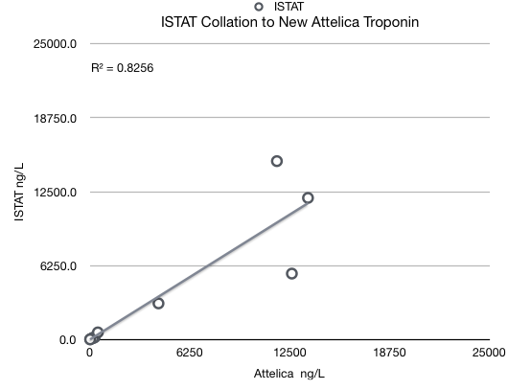
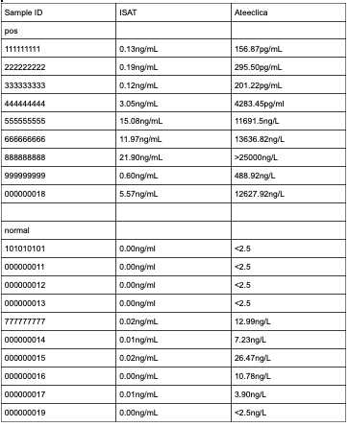
ISTAT
Reference Range: 0.00-0.08ng/mL
Reportable Range: 0.00-50.00ng/mL

Slide 9
ISTAT
IDEA?
Reference Range: 0.00-0.08ng/mL
Reportable Range: 0.00-50.00ng/mL

Slide 10
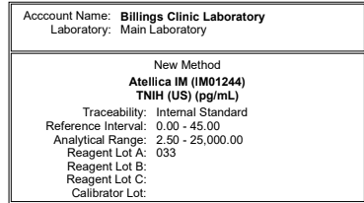
Ranges
Vista
New Atellica

Slide 11
What’s next:
Sex-specific reference range
Seimen

Slide 12
Special thanks to:
Meet Patel
Mykal Ann Anzink
Siemens Tech
and
Billings Clinic Staff
For taking time to help me with this project.

Slide 13
Reference Page
[1]AACC. (2019, January 9). Troponin. Retrieved January 20, 2020, from https://labtestsonline.org/tests/
Castellani, MD, FCAP, W. (2013, March 20). Analytical Measurement Range: Examples and Approaches. Retrieved March 1, 2020, from https://webapps.cap.org/apps/docs/education/lapaudio/pdf/032013
[2]Christenson, R. H., Peacock, W. F., Apple, F. S., Limkakeng, A. T., Jr, Nowak, R. M., McCord, J., & deFilippi, C. R. (2019). Trial design for assessing analytical and clinical performance of high-sensitivity cardiac troponin I assays in the United States: The HIGH-US study. Contemporary clinical trials communications, 14, 100337. https://doi.org/10.1016/j.conctc.2019.100337
[3]Lister, A. s. (2005). Repeatability. Retrieved March 1, 2020, from https://www.sciencedirect.com/topics/agricultural-and-biological-sciences/repeatability
[4]Siemens Medical Solutions USA. (2020). Cardiac Troponin. Retrieved March 1, 2020, from https://www.siemens-healthineers.com/en-us/laboratory-diagnostics/assays-by-diseases-conditions/cardiac-assays/cardiac-troponin-assays#High-Sensitivity_Troponin_I
[5]]Wu, A. H. B., Christenson, R. H., Greene, D. N., Jaffe, A. S., Kavsak, P. A., Ordonez-Llanos, J., & Apple, F. S. (2018). Clinical Laboratory Practice Recommendations for the Use of Cardiac Troponin in Acute Coronary Syndrome: Expert Opinion from the Academy of the American Association for Clinical Chemistry and the Task Force on Clinical Applications of Cardiac Bio-Markers of the International Federation of Clinical Chemistry and Laboratory Medicine. Clinical Chemistry, 64(4), 645–655. doi: 10.1373/clinchem.2017.277186

