Slide 1
ePlex Respiratory Pathogen Panel
Improved Diagnosis in Youth and Elderly Populations
Presented By: Melissa Reasoner

Slide 2
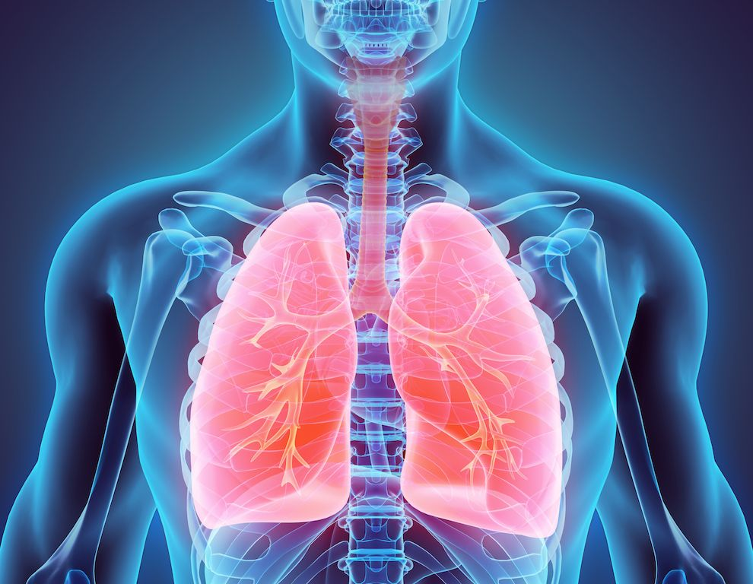
Why
Respiratory Tract Infections → 4th leading cause of death in the world
World Health Organization - 2016
Determining the causative agent of a respiratory tract infection is difficult
Numerous possible pathogenic suspects
Accurate diagnosis of of the causative agent
Reduced length of stay in isolation
Reduced length of stay in the hospital
Reduced duration of antibiotic use
Cost savings for both the patient and institution
70% of medical decisions depend on laboratory test results
Centers for Disease Control and Prevention - 2018

Slide 3
Goals
In this study, I analyzed the frequency of pathogens detected across several different age specific populations using the ePlex Respiratory Pathogen Panel. My goal was to assess the cost effectiveness of the ePlex in relation to faster turnaround times, increased sensitivity and specificity, minimized cost, and diagnosis of co-infections.

Slide 4
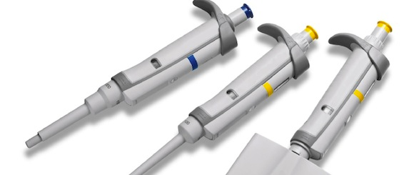
The Right Instrumentation
High precision / High accuracy
Customer Satisfaction
Fast turnaround times
Cost efficient budgets.
Latest innovative technology
Greatest potential for growth

Slide 5
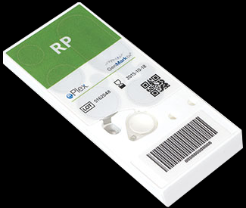
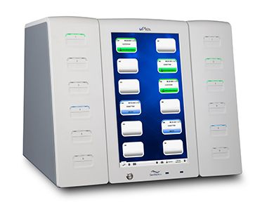
ePlex Respiratory Pathogen Panel
Multiplexed nucleic acid in vitro diagnostic test
Faster turnaround times:
Bacterial or viral cultures
Antigen detection assays (Immunofluorescence / Radiography)
Higher sensitivity and specificity
Rapid viral tests (Roche Liat Flu Test)
Cheaper Cost (Less sensitive and specific)
MALDI-TOF MS
Gene sequencing

Slide 6
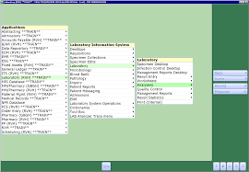
Methods and Materials
Testing Controls
521 specimens were ordered and resulted at St. Peter’s Health
2475 E. Broadway St., Helena, MT 59601
Specimens analyzed were from 01/01/2020 – 03/30/2020
Laboratory Information System – Meditech
Specimens were collected using nasopharyngeal swabs
269 Positive Specimens / 252 Negative Specimens
Internal controls for extraction, bead delivery, movement within the cartridge, amplification, digestion, and hybridization are built into each cartridge.
Positive and negative external controls are routinely performed.
With each new lot and shipment of cartridges
At a minimum of every 30 days
All control fails or discrepant results were excluded from this study.

Slide 7
ePlex Respiratory Pathogen Panel
Developed by GenMark Diagnostics, Inc from Carlsbad, CA
Competitive DNA hybridization / Electrochemical detection
Nucleic acid extraction / Amplification / Detection combined in a single cartridge per patient
Test Run Time – 90 minutes
Electrowetting – Electric fields directly manipulate discrete droplets onto surfaces of hydrophobically coated circuit boards
Magnetic solid phase – Extraction and purification
PCR – Target amplification
Ferrocene labeled signal probes bind to amplified DNA/RNA
Ferrocene complex binds to capture probes (Pre-bound to gold plated electrodes)
Voltammetry detects the target DNA/RNA through specific electrical signals generated from ferrocene labeled signal probes bound to the gold plated electrodes.

Slide 8
Testing Methodology
Nasopharyngeal swabs collected in Universal Viral Transport Media
Level 2 biosafety hood cleaned with 10% bleach followed by 70% ethanol
Swabs vortexed for 5 seconds
Using a calibrated pipette 200µL of specimen placed in 150µL of buffer
Buffer solution vortexed for 10 seconds
Entire buffer solution is pipetted into the ePlex cartridge.
ePlex cartridge and patient ID barcode are scanned into the ePlex system
ePlex cartridge is inserted into any available bay.
Testing starts automatically and runs for approximately 90 minutes.

Slide 9
Test Pathogens
Adenovirus
Coronavirus
Human metapneumovirus (HMPV)
Human rhinovirus / enterovirus (HRV)
Influenza A (A / A-H1 / A-H1-2009 / A-H3) (FluA)
Influenza B (FluB)
Parainfluenza virus (1 / 2 / 3 / 4) (PIV)
Respiratory Syncytial Virus (A / B) (RSV)
Chlamydia pneumoniae
Mycoplasma pneumoniae

Slide 10
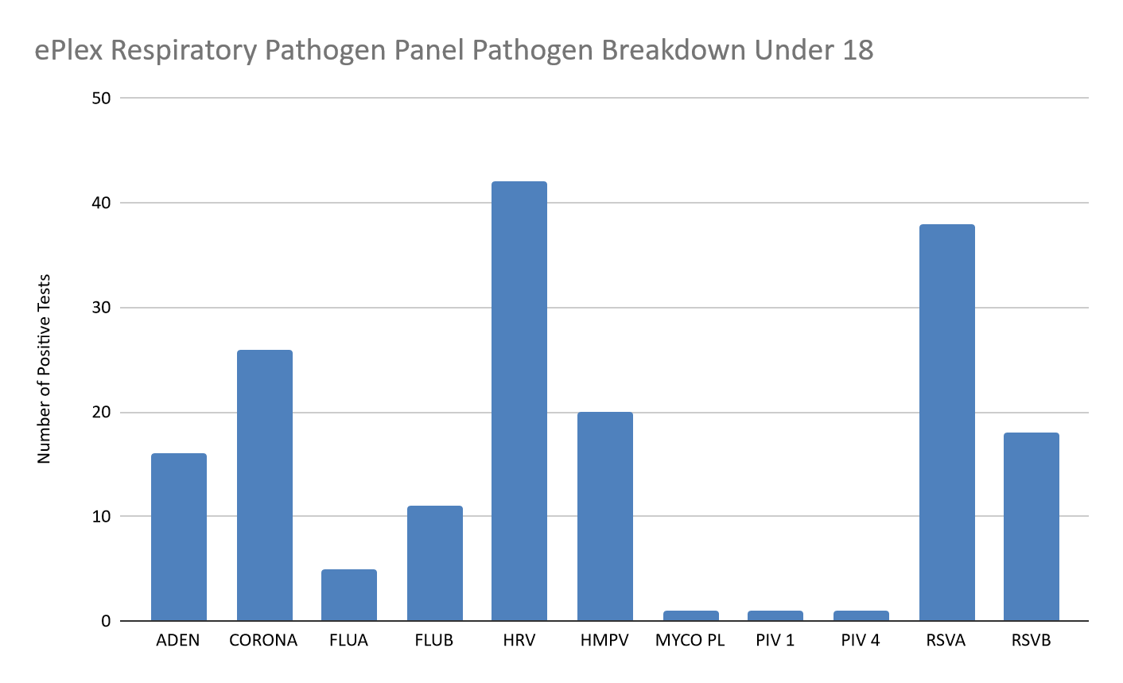
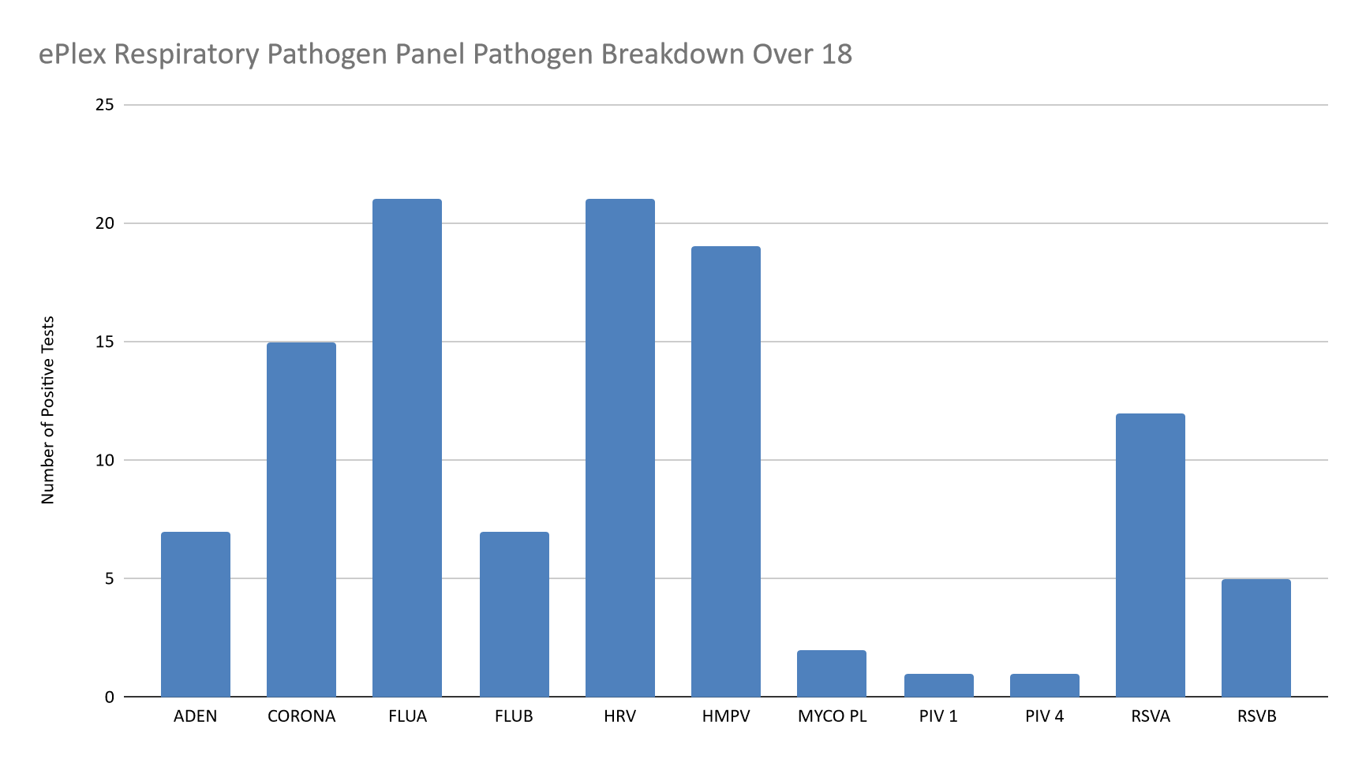
Under 18
Total: 143 positive test results
# 1: Human Rhinovirus/Enterovirus
Over 18
Total: 126 positive test results
#1: Human Rhinovirus/Enterovirus / Influenza A

Slide 11
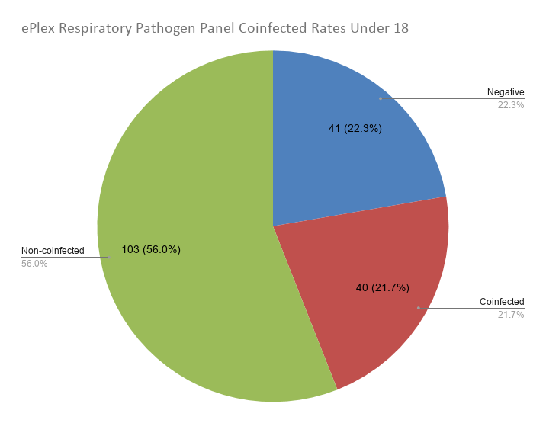
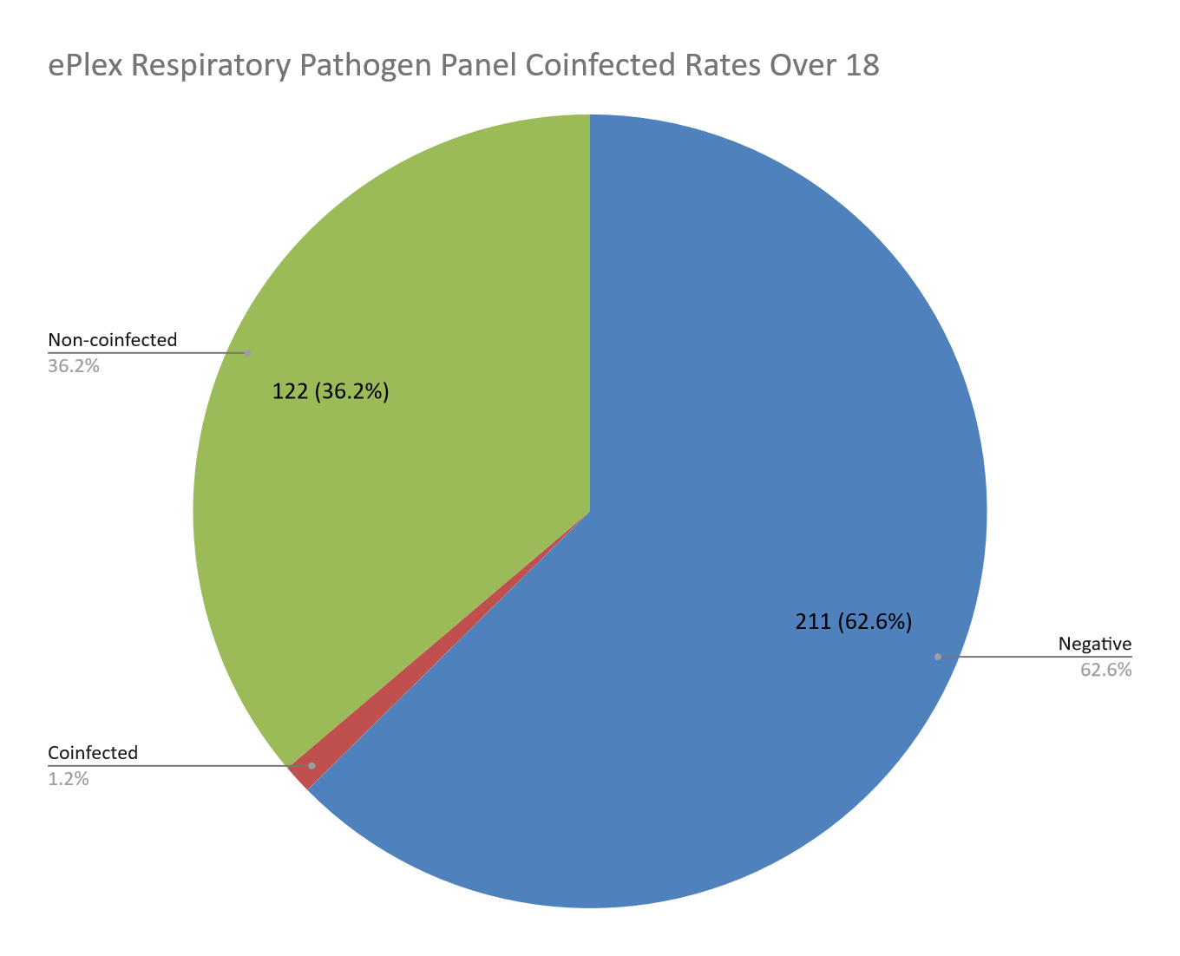
4 (1.2%)

Slide 12
Discussion
Co-infections are far more prevalent in children.
The eplex is a useful tool in the diagnosis of children
Children present with higher co-infection rates
Alternative testing may be more appropriate for adults initially
Adult co-infection rates are much smaller.
The Roche Liat Flu Test is a viable alternative in adult diagnosis
The most common detected pathogen in adults was Influenza
The Roche Liat Flu Test costs about $50 (The ePlex cost about $1000)
The Roche Liat Flu Test is 20 minutes (The eplex is 90 minutes)
Testing should be based on a case-by-case basis (Severity of symptoms)
Notes:
Perhaps we should be more be frugal and economical in our test ordering. Many patients look like the flu, smell like they flu. We should begin with a flu test. In the ER many times both are ordered simultaneously which I believe is waste of time and money. If the patient is not critical I do not believe waiting 20 minutes for the flu test to result before starting the eplex would significantly alter the patient’s prognosis.

Slide 13
An accurate diagnosis is vital in the elderly, children, and immunocompromised individuals because they are more susceptible to morbidities with higher severity and more susceptible to co-infections.

Slide 14
Multiple Choice Question
The ePlex cannot reliably differentiate between some organisms because of genetic similarities. Which organism can the ePlex reliably differentiate?
A. Enterovirus
B. Influenza B
C. Poliovirus
D. Rhinovirus

Slide 15
Multiple Choice Question
The ePlex cannot reliably differentiate between some organisms because of genetic similarities. Which organism can the ePlex reliably differentiate?
A. Enterovirus
B. Influenza B
C. Poliovirus
D. Rhinovirus

Slide 16
References
Division of Laboratory Systems. (2018, November 15). Strengthening Clinical Laboratories.
Centers for Disease Control and Prevention. Retrieved from https://www.cdc.gov/csels/dls/strengthening-clinical-labs.html
European Respiratory Society. (2017). The Global Impact of Respiratory Disease - Second
Edition. Forum of International Respiratory Societies. Retrieved from
https://www.who.int/gard/publications/The_Global_Impact_of_Respiratory_Disease.pdf
Niijhuis, R. H. T., Guerendiain, D., Claas, E. C. J., & Templeton, K. E. (2017). Comparison of
ePlex Respiratory Pathogen Panel with Laboratory Developed Real Time PCR Assays for Detection of Respiratory Pathogens. Journal of Clinical Microbiology, 55(6), 1938–1945. https://doi.org/10.1128/JCM.00221-17
Rogers B. B., Shankar P., Jerris R. C., Kotzbauer D., Anderson E. J., Watson J. R., O’Brien L.
A., Uwindatwa F., McNamara K., & Bost J. E. (2015). Impact of a rapid respiratory panel test on patient outcomes. Arch Pathol Lab Med, 139(5):636-41. https://doi.org/10.5858/arpa.2014-0257-OA
World Health Organization. (2018, May 24). The Top 10 Causes of Death. Retrieved from
https://www.who.int/news-room/fact-sheets/detail/the-top-10-causes-of-death/

Slide 17
References (Pictures)
THANK YOU
https://www.livescience.com/22616-respiratory-system.html
https://atlanticscale.com/best-practices-for-pipette-use-calibration/
https://www.globenewswire.com/news-release/2020/03/20/2003794/0/en/GenMark-Receives-FDA-Emergency-Use-Authorization-for-its-ePlex-SARS-CoV-2-Test.html
https://www.genmarkdx.com/solutions/panels/eplex-panels/respiratory-pathogen-panel/
https://www.abmolecular.co.uk/genmark-dx/
https://www.csmls.org/csmls/media/documents/Michener-LIS-Feb-2017.pdf
https://www.europeanpharmaceuticalreview.com/news/64360/flu-mutation-vaccine-production/

